Slide 1
Perspectives: The Battle of New Orleans
The War of 1812 Curriculum

Slide 2
War of 1812 in 4 Minutes
Notes:
YouTube Video Link: https://youtu.be/elp6ZktpQ1c?si=ZZSlCGYmQ00qROSm
Website Video Link: https://www.battlefields.org/learn/videos/war-1812

Slide 3
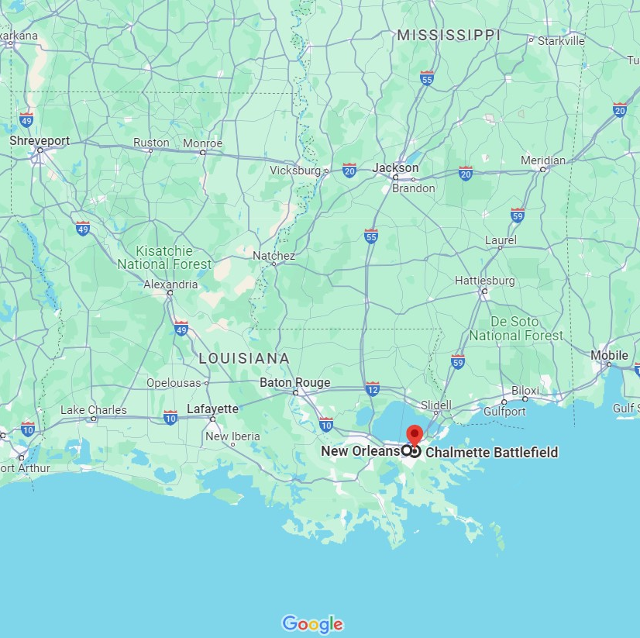
Modern Map of the location of New Orleans
Chalmette Battlefield is where the Battle of New Orleans was fought on January 8, 1815.
Chalmette is located about 5 miles by land from historic New Orleans.
Notes:
Learn more about Chalmette Battlefield: https://www.battlefields.org/visit/battlefields/chalmette

Slide 4
New Orleans
1718 – French colonists founded the city of New Orleans.
Over the following decades of the 18th Century, Spanish and French controlled and built the city.
The location controls the connection of the Mississippi River to the Gulf of Mexico.
New Orleans had a huge import/export economy and was very multi-cultural.
The United States acquired New Orleans through the Louisiana Purchase in 1803.
Notes:
Extra Resources:
The Founding of New Orleans: https://www.battlefields.org/learn/articles/founding-new-orleans
At the beginning of the 19th century, the Spanish crown retroceded Louisiana back to France under the reign of Napoleon. United States President Thomas Jefferson began negotiations with France on the purchase of the Louisiana territory. The United States wanted to buy the territory to gain access to the Mississippi River and the port of New Orleans. Future president James Monroe and Robert Livingston, the United States minister to France, were sent to negotiate with Napoleon and the French government on the price of Louisiana. When Monroe arrived in Paris in 1803, Livingston informed him that France would sell the entire territory for a set price. On April 30, an agreement was reached that the United States would buy 827,000 square miles (about twice the area of Egypt), including New Orleans, for 15 million dollars. The purchase announcement was made on July 4, 1803, in Washington, D.C. The Senate ratified the Louisiana Purchase Treaty on October 20, and New Orleans and Louisiana territory officially joined the United States on December 30, 1803.

Slide 5
1814: Targeting New Orleans
Following the Chesapeake Campaign (1813-1814), the British targeted New Orleans.
New Orleans could be a negotiating chip for the British during the discussions of the Treaty of Ghent in Europe which would end of the War of 1812.
Notes:
Extra Resources: https://www.battlefields.org/learn/articles/battle-new-orleans-last-battle-war-1812
New Orleans was the gateway to the continent. Its capture would give the British control of the Mississippi River and access to the interior. The British could cut off the westward expansion of the United States and give them full command of the resources in the Louisiana Territory. Economically, one-third of American produce passed through New Orleans. Additionally, due to the British blockade, nearly 14 million dollars of cotton sat on the city docks. Politically, New Orleans represented a critical bargaining chip during the ongoing peace negotiations at Ghent, Belgium.

Slide 6
Treaty of Ghent
American and British diplomats became meeting in August 1814 in Ghent, Belgium to negotiate a treaty to end the War of 1812.
On December 24, 1814, they signed the Treaty of Ghent and sent it to their countries for ratification.
A ship taking the treaty to the United States left on January 2, 1815.
(On January 8, 1815, the Battle of New Orleans was fought.)
The United States Senate ratified the treaty on February 16, 1815.
Notes:
Extra Resources:
Treaty of Ghent: https://www.battlefields.org/learn/articles/treaty-ghent-ending-war-1812
By late 1814, both sides eagerly sought peace. The Napoleonic Wars were ending in Europe, freeing up British forces to commit to the American conflict. American politicians feared an escalation accordingly. At the same time, the threat of impressment into the British navy—which had been such a significant cause of the war— diminished. Finally, the American economy suffered severely from the lack of trade with Britain, especially in the New England States.
Five peace commissioners represented American interests at the negotiations: John Quincy Adams, Albert Gallatin, Henry Clay, Jonathan Russell, and James A. Bayard. Adams, Gallatin, and Bayard had been appointed in 1813, when the Russian government had offered to mediate peace talks, but their original efforts at peace failed when neither side would compromise on the issue of impressment. All five were skillful negotiators, and most had distinguished political careers.
Admiral James Gambier, Dr. William Adams, and Henry Goulburn represented British interests in the negotiations for peace, although they had somewhat less authority than the Americans did and often referred difficult questions back to London. Negotiations between the two teams began on August 8, 1814, in Ghent, Belgium.
The treaty was signed on Christmas Eve and ratified by the British government on December 27th, but would not take effect until ratified by both sides. This condition had been a British proposal, designed to pressure the American government into quickly accepting the terms of the treaty. A ship bearing the treaty departed on January 2, 1815. While the ship was still in transit, General Andrew Jackson defeated British forces at the Battle of New Orleans, a significant victory for both commerce and American morale. But on February 13th, news of the treaty arrived in Washington, DC, and it was approved unanimously by the Senate on February 16th

Slide 7
The British Fleet & Army
Admiral Alexander Cochrane commanded the British fleet that appeared off the Louisiana coast in December 1814.
General Edward Pakenham (pictured) commanded the British infantry during the main inland attack.
Notes:
Extra Resources:
Admiral Alexander Cochrane: https://www.battlefields.org/learn/biographies/alexander-cochrane
General Edward Pakenham: https://www.battlefields.org/learn/biographies/edward-pakenham

Slide 8
Defending New Orleans
General Andrew Jackson arrived at New Orleans on December 1, 1814.
Jackson organized a force of militia, frontiersmen, French-Creole, Spanish, Native American, free African Americans, and even pirates to defend the city from the British.
There were military movements in December 1814, but the main battle was fought on January 8, 1815.
Notes:
Extra Resources:
Andrew Jackson: https://www.battlefields.org/learn/biographies/andrew-jackson
Naval Engagements around New Orleans during the War of 1812: https://www.battlefields.org/learn/articles/naval-engagements-around-new-orleans-during-war-1812
Battle of New Orleans: https://www.battlefields.org/learn/articles/battle-new-orleans-last-battle-war-1812
Local militia along with U.S. infantry, Marines, and a Naval detachment garrisoned the city. Militia from Tennessee and Kentucky were also en route to join Jackson at New Orleans.
Jackson arrived in New Orleans on December 1. A week later Cochrane’s fleet arrived off Ship Island, 60 miles east of the city. Jackson relied on a flotilla in nearby Lake Borgne to provide information on the British movements. Cochrane dispatched ships that destroyed the American gunboats on December 14. In full control of Lake Borgne, Cochrane decided to move through and land below New Orleans.
Navigating the lake and bayous, lead elements of the British army landed at the Villere Plantation on December 23. Apprised of the British presence, Jackson, decided to attack instead of taking defensive actions. The Americans approached the British camp around dusk on December 23. Jackson coordinated his advance with the USS Carolina, whose opening shot would be the signal to advance. Their bombardment completely surprised the British. Ten minutes into the barrage, Jackson ordered his men forward. The two sides battled in the growing dark with neither able to gain the upper hand. With visibility reduced due to fog and black powder smoke, Jackson decided to disengage and break off the battle.

Slide 9
The Battle of New Orleans in 4 Minutes
Notes:
YouTube Video Link: https://youtu.be/xXHgLATmxwc?si=18RYHrQw6jSxpy8_
Website Video Link: https://www.battlefields.org/learn/videos/battle-new-orleans

Slide 10
Battle of New Orleans
January 8, 1815
The American force commanded by General Andrew Jackson defeated the British land attack led by General Edward Pakenham.
General Pakenham was killed during the attack.
The British force did not reach New Orleans, and the Americans won the battle.
Later in the January, British soldiers returned to their ships, and in February, the British ships retreated.
News of the Treaty of Ghent ended the War of 1812 and military maneuvering.
A significant American victory at the end of the War of 1812 inspired national pride and satisfaction over the war's outcomes in the United States.
Notes:
Extra Resources:
The Battle of New Orleans: https://www.battlefields.org/learn/articles/battle-new-orleans-last-battle-war-1812
Andrew Jackson: "Old Hickory" Adored and Despised: https://www.battlefields.org/learn/articles/andrew-jackson-old-hickory-adored-and-despised
On January 8, the British struck using a complicated plan that involved attacks on both sides of the Mississippi River. General Edward Pakenham, the British commander, attacked even as the fog lifted and uncovered his men. The assault was a disaster. In roughly 30 minutes, 2,000 British soldiers became casualties. Among the dead was Pakenham and his second in command, Samuel Gibbs. After the third in command, John Keane, was shot in the groin, command devolved to John Lambert, an uninspired soldier. Even though the attack on the west bank, which had been delayed, succeeded, Lam­bert withdrew. Efforts instead shifted to taking Fort St. Philip, the main strong point defending New Orleans from river assault. That siege also failed.
Unbeknownst to Jackson and Pak­enham, however, the War of 1812 had essentially come to a close. Both sides had signed the Treaty of Ghent on December 24, 1814, although it still needed to be ratified by Congress. The victory in New Orleans brought to a close with a resounding victory a conflict that had seen numerous military disasters for the Americans. And, in earning a victory that ensured that New Orleans would not be sacked or set alight like the White House, Jackson became a national hero.

Slide 11
National Hero & A City Saved
Andrew Jackson became a national hero for his victory at the Battle of New Orleans.
He became the 7th President of the United States in 1829.
New Orleans continued to grow as a center of commerce in the decades following the end of the War of 1812.
Notes:
Extra Resources:
The Battle of New Orleans: https://www.battlefields.org/learn/articles/battle-new-orleans-last-battle-war-1812
Andrew Jackson: "Old Hickory" Adored and Despised: https://www.battlefields.org/learn/articles/andrew-jackson-old-hickory-adored-and-despised
On January 8, the British struck using a complicated plan that involved attacks on both sides of the Mississippi River. General Edward Pakenham, the British commander, attacked even as the fog lifted and uncovered his men. The assault was a disaster. In roughly 30 minutes, 2,000 British soldiers became casualties. Among the dead was Pakenham and his second in command, Samuel Gibbs. After the third in command, John Keane, was shot in the groin, command devolved to John Lambert, an uninspired soldier. Even though the attack on the west bank, which had been delayed, succeeded, Lam­bert withdrew. Efforts instead shifted to taking Fort St. Philip, the main strong point defending New Orleans from river assault. That siege also failed.
Unbeknownst to Jackson and Pak­enham, however, the War of 1812 had essentially come to a close. Both sides had signed the Treaty of Ghent on December 24, 1814, although it still needed to be ratified by Congress. The victory in New Orleans brought to a close with a resounding victory a conflict that had seen numerous military disasters for the Americans. And, in earning a victory that ensured that New Orleans would not be sacked or set alight like the White House, Jackson became a national hero.

Slide 12
Primary Sources
Battle of New Orleans:
"To Describe Those Lines"
"Pakenham Gave the Word to Advance"
After the Battle:
"In Praise of the Firmness and Deliberation"
"Bravely Facing the Dangers of War"
"They threw themselves on his protection"
"Address of General Jackson to the Soldiers and Citizens at New Orleans"
A Tribute to defenders of New Orleans
Notes:
View the Lesson Plan Teaching Guide for links to these Primary Sources, worksheets, and discussion suggestions.

Slide 13
Notes:
Always more FREE resources at www.battlefields.org

