Slide 1
War of 1812: Causes
The War of 1812 Curriculum

Slide 2
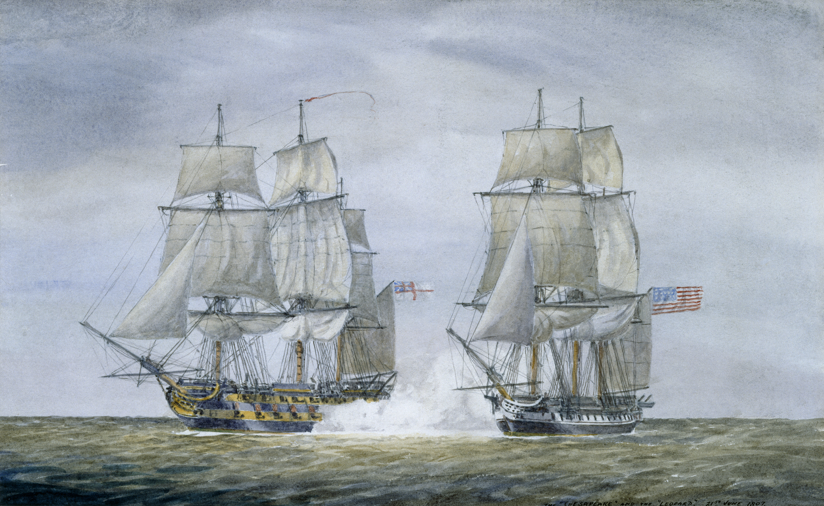
Essential Question
What are some of the reasons the United States went to war in 1812?
Notes:
Extra Resources:
"Chesapeake vs. Leopard, June 21, 1807" painting https://www.humanitiestexas.org/archives/digital-repository/bevan-chesapeake-vs-leopard-june-21-1807
Encourage students to think about how there were many causes and that the nation was not united in the interest of going to war.

Slide 3
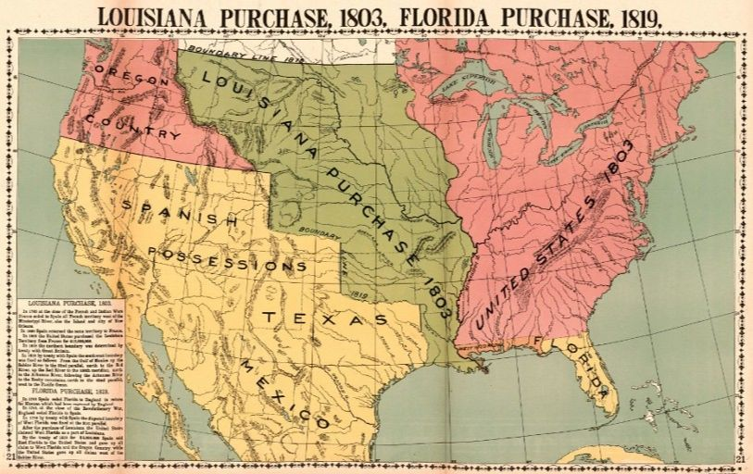
Post-Revolution America
After the revolution, the U.S. focused on westward expansion
Trade deals with France
Louisiana Purchase
Encroachment on British land
Conflicts with Native Americans on the western frontier
Notes:
Extra Resources:
"Expansion and Exploration in the New Republic: The Louisiana Purchase and the Lewis and Clark Expedition" article https://www.battlefields.org/learn/articles/expansion-and-exploration-new-republic-louisiana-purchase-and-lewis-and-clark
When the Treaty of Paris ended the American Revolution in 1783, the westernmost boundary of the United States was the Mississippi River. Throughout the eighteenth century, New Orleans drifted between French and Spanish control. By 1803 France was back in control of New Orleans, but the French Emperor Napoleon Bonaparte was cash strapped. For some time, Napoleon considered a French North American Empire, but after the insurgency in Haiti, he changed his mind. Initially Jefferson was simply interested in purchasing New Orleans, but when Napoleon offered the American negotiation minister, James Monroe, the whole of the Louisiana Territory, Jefferson happily accepted the deal. It is of interest to note that under Constitutional mandate, only Congress can sign a treaty with a foreign power. Jefferson, in a move that would have made Alexander Hamilton proud, side-stepped the Constitution and ordered his minister to cinch the deal. The Louisiana Purchase effectively doubled the size of the United States. What would become Arkansas, Iowa, Missouri, Kansas, Oklahoma, and Nebraska and parts of present-day New Mexico, South Dakota, Texas, Wyoming, Montana, and Colorado would all eventually emerge from the new territory.
Possible discussion question: Why do you think the Native Americans and the British might have been unhappy with the Louisiana Purchase's effects?

Slide 4
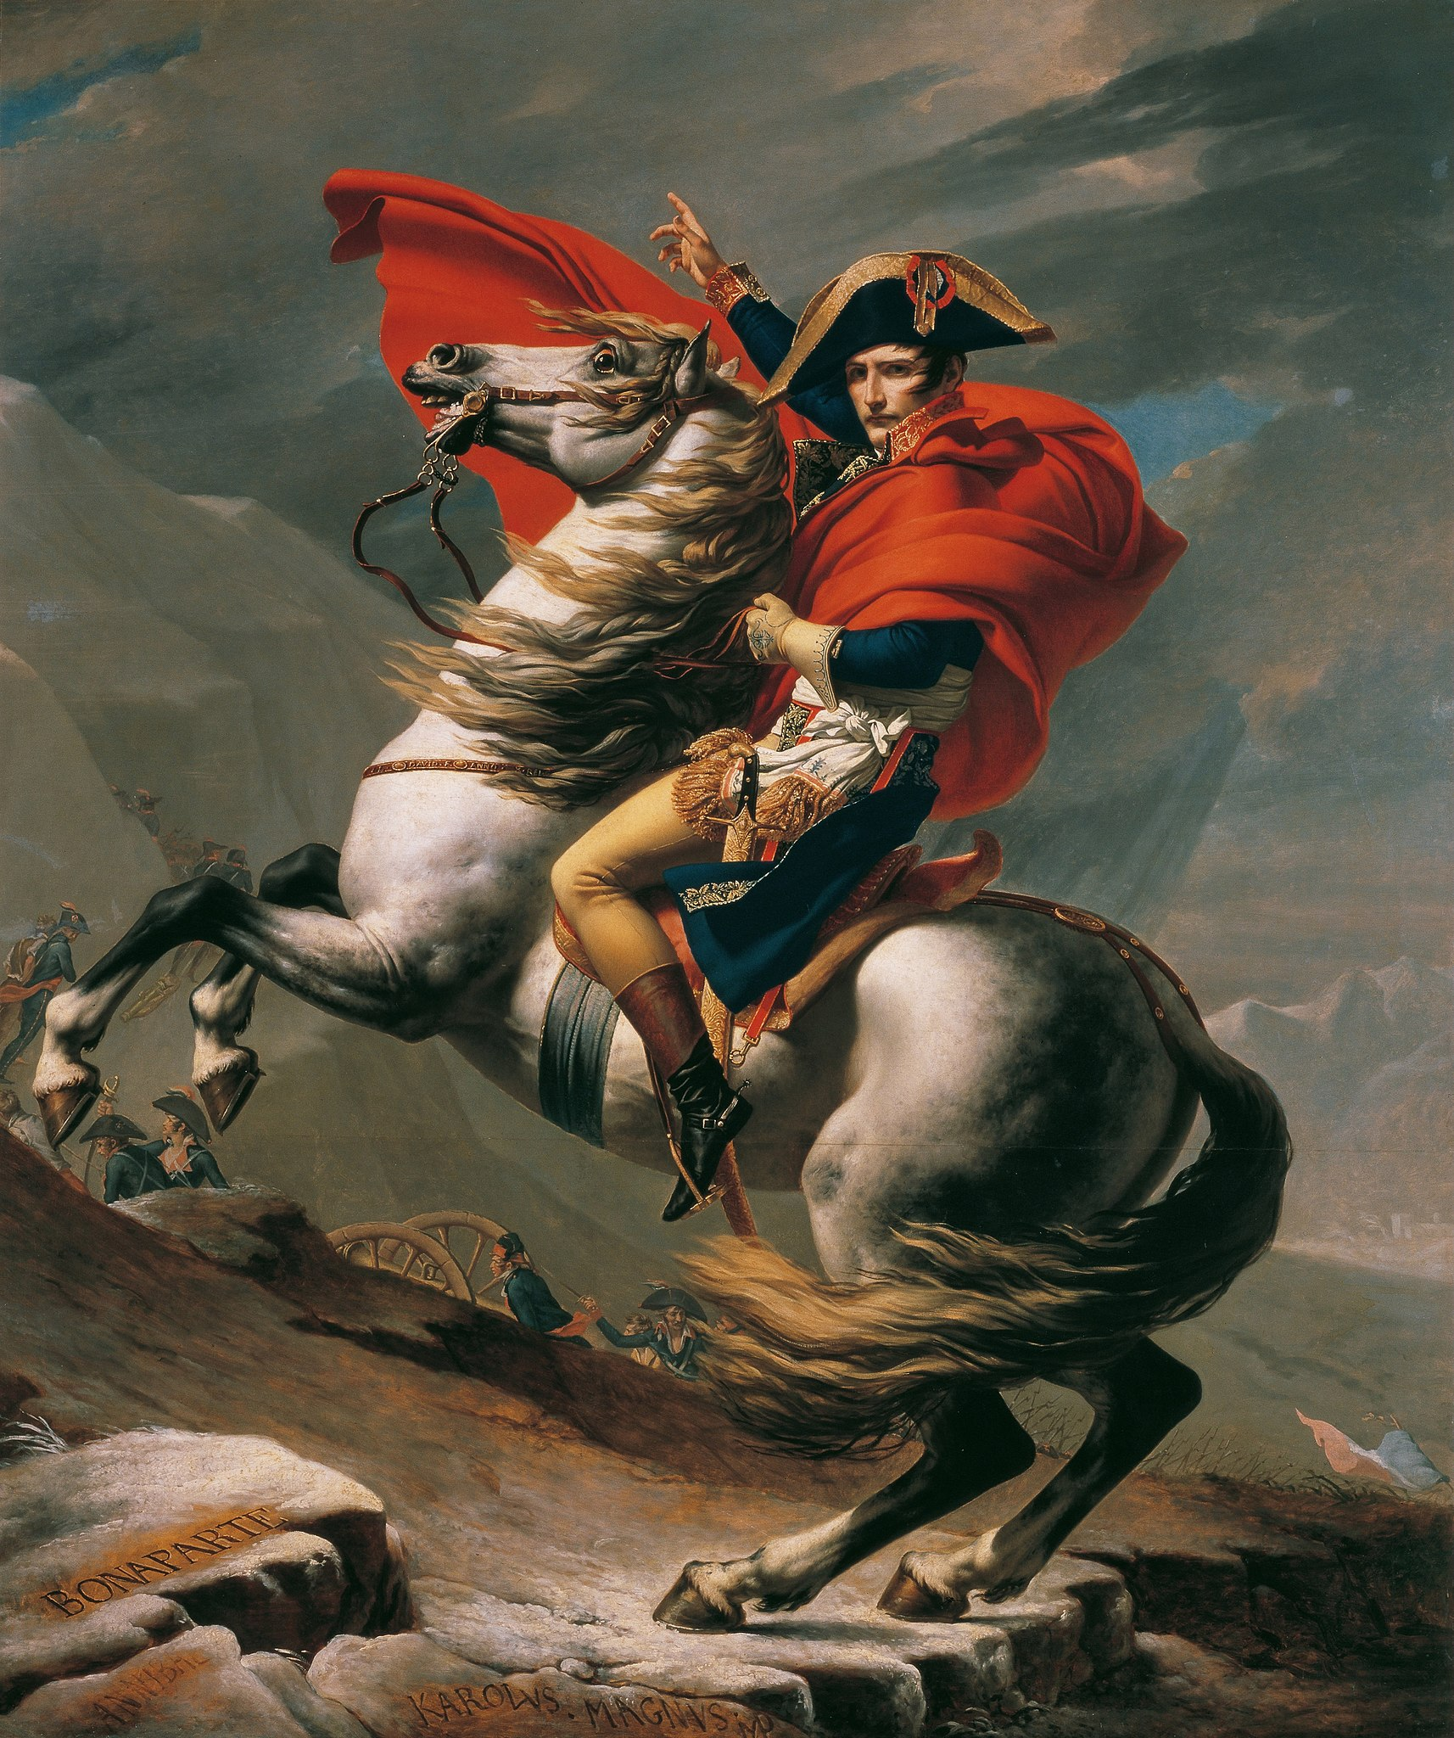
Britain, France, and the United States
Britain and France vied for North American control during the French and Indian War
Colonists relied on French support during the Revolutionary War
The French Revolution threw France into turmoil
Unresolved issues from the revolution led to the Napoleonic Wars of 1793-1815
Napoleon Bonaparte I rose to power
Britain was involved in this era of European wars
Notes:
Extra Resources:
Napoleon Bonaparte portrait https://www.history.com/topics/european-history/napoleon
"Napoleon and America" article https://www.battlefields.org/learn/articles/napoleon-and-united-states
Becoming entangled in European affairs proved to be a tightrope for the administration of the first president, George Washington, and the several presidents who followed. These foreign policy difficulties would linger until 1815, ending with closure of the War of 1812. Complicating matters was the explosive French Revolution of 1789. Some like Jefferson saw it as a natural outgrowth of the American Revolution as putting to an end, monarchy. But as the French Revolution devolved into chaos, ruthless murder, and terror others including Washington and his Vice-President and the second President of the United States, John Adams saw things differently. In 1792, the French monarchy collapsed, and Revolutionary France declared war on England.
Possible discussion question: Why might the American Revolution have inspired the French to also pursue revolution?

Slide 5
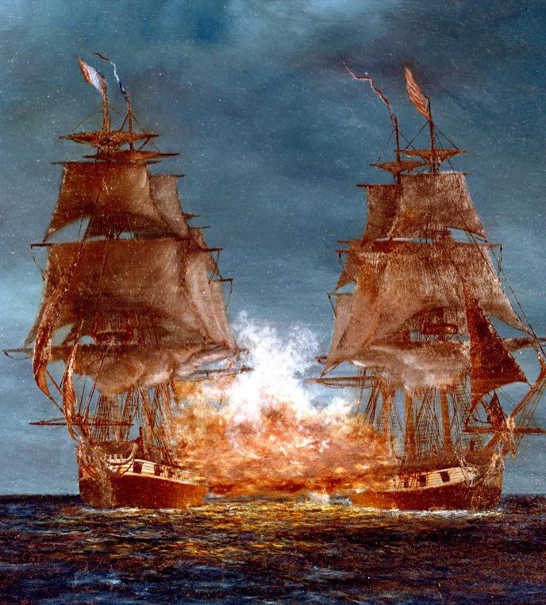
The Quasi-War
Jul 7, 1798 – Sep 30, 1800
Washington declared a statement of neutrality- would not aid France in their revolution
France demanded that America either honor the Treaty of Alliance against Britain— or at least pay back some of the debt they owed France from the Revolutionary War
President John Adams wanted the navy to be independent and strong
Rallied for congressional authorization of warships
America warships fought against French privateers on July 7, 1798
Notes:
Extra Resources:
"Quasi-War with France, 1798-1800" painting https://www.history.navy.mil/content/history/museums/nmusn/explore/photography/ships-us/ships-usn-c/uss-constellation-frigate-1797-1853/kn-3491.html
"The Quasi-War" article https://www.battlefields.org/learn/articles/quasi-war
Washington’s position of neutrality infuriated the French. Under Washington, both the army and the navy fell under the responsibility of the War Department, but Adams thought it wise to give the Navy a degree of independence to pursue its own operations during peacetime. He convinced Congress to enhance the American Navy. Later, Congress authorized warships to target French privateers on July 7— the beginning of the Quasi-War. From the European perspective, it can be tempting to see Bonaparte playing the Americans for fools by ending the Quasi-War, but in fact, President John Adams had accomplished much of what he set out to do: keeping the United States out of the war and establishing the centrality of the Navy in American foreign policy. The Quasi-War helped to establish the United States as a strong naval power to be reckoned with on the world stage.
Possible discussion question: Do you agree with the Washington's decision to uphold statement of neutrality? Why or why not?

Slide 6
Revolutionary War ends
Chesapeake-Leopard Affair
(U.S. & Britain)
U.S. declares war on Great Britain
France declares war on Great Britain
1783 1789 1793 1798 1807 1811 1812
French Revolution
Battle of Tippecanoe
(U.S. & Native Americans)
Quasi War
(U.S. & France)
Notes:
Extra Resources:
"What Caused the War of 1812?" video https://www.battlefields.org/learn/videos/untold/what-caused-war-1812
Possible discussion question: Does anything surprise you about the timeline of events between 1783 and 1812?

Slide 7
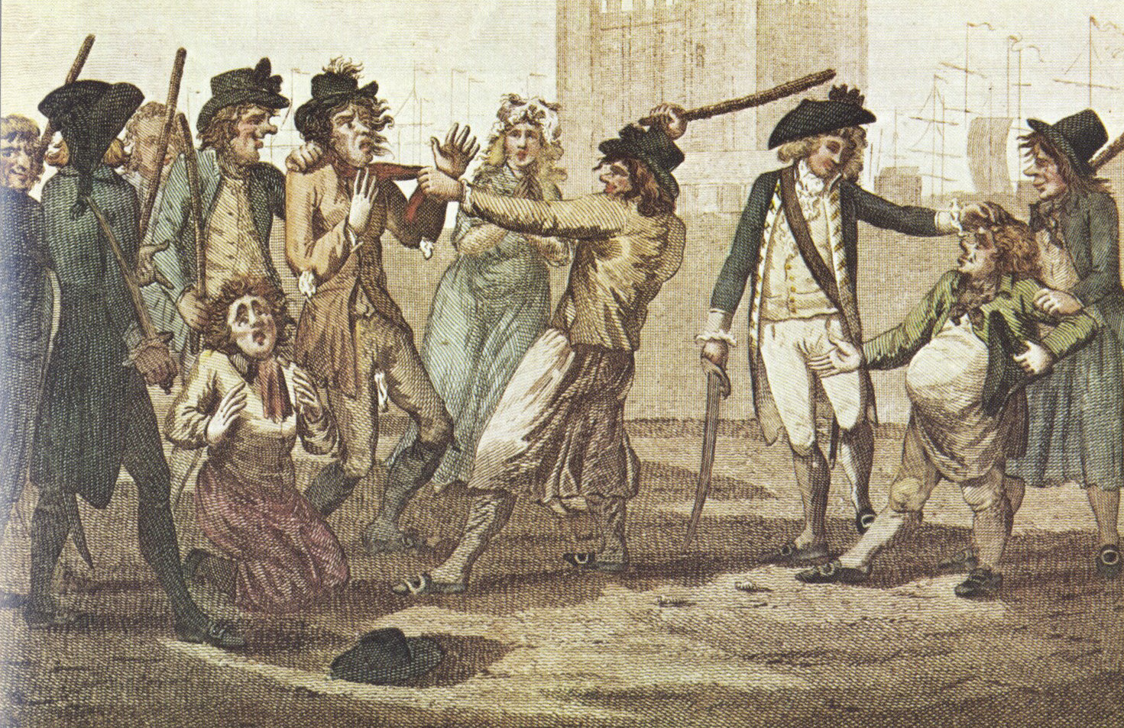
Chesapeake-Leopard Affair
June 22, 1807
The British warship HMS Leopard attacked the USS Chesapeake after the American ship refused a search upon their ship to submit to a search
British sailors boarded the Chesapeake
James Barron, captain of the Chesapeake, surrendered the ship
impressment:
forcing American sailors to join British Navy
Notes:
Extra Resources:
Drawing source https://en.wikipedia.org/wiki/Impressment#/media/File:Caricature-1780-press_gang.jpg
"British Impressment" article https://www.battlefields.org/learn/articles/impressment
James Barron biography https://www.battlefields.org/learn/biographies/james-barron
Compounding the maritime trade issue was "impressment." This was a system employed by the Royal Navy to fill its great need for sailors in its life-or-death struggle with France. At the core of the issue was citizenship. The British considered a person’s place of birth as their citizenship, while the United States considered a period of residency as their basis. This meant that the Royal Navy was at times impressing sailors that the United States considered its own citizens. Exacerbating this was the Royal Navy practice of stopping any American ship, both merchant and military, to search for deserters, British citizens, or cargo bound for France. The best example of this is the Chesapeake-Leopard Affair, when a British warship opened fire on an American frigate for refusing to stop and consent to search, resulting in four American deaths and seventeen wounded, along with four Royal Navy deserters pressed. Impressment was seen as a gross insult by Great Britain.
Possible discussion question: Why do you think the British navy wanted to "impress" American sailors?

Slide 8
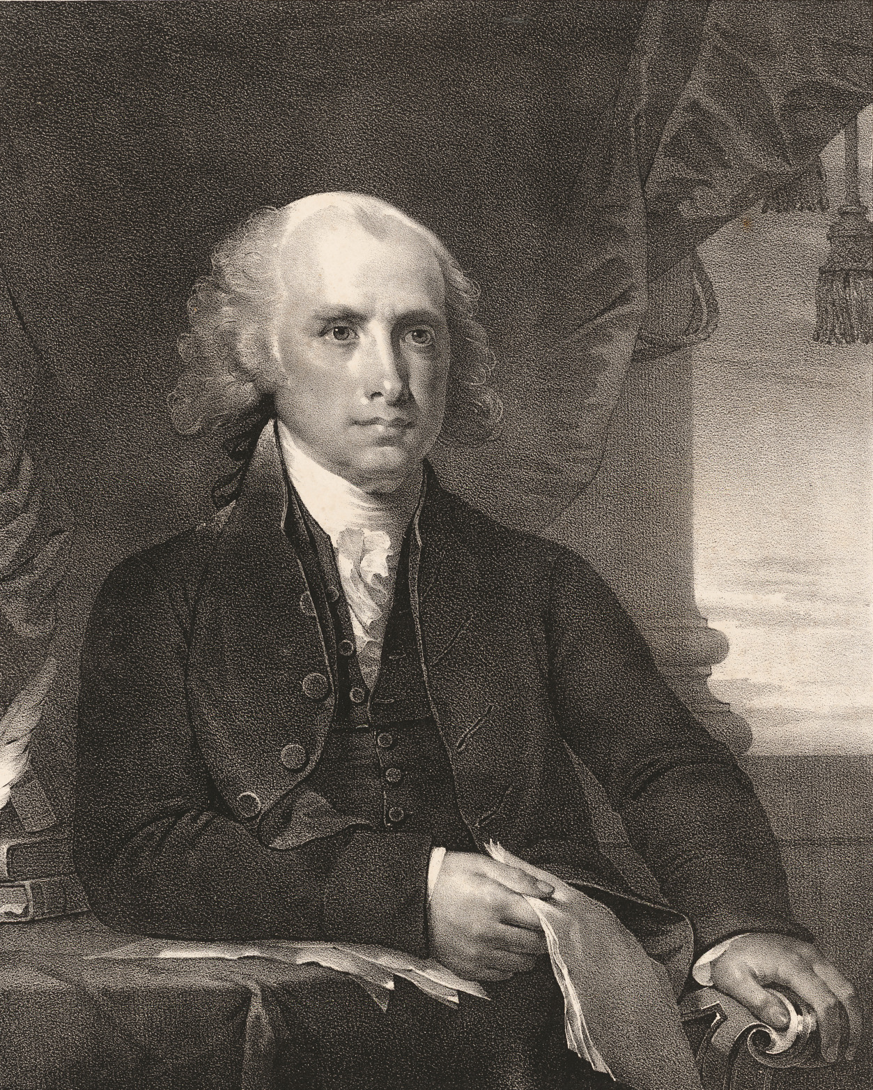
Rocky Waters
President Thomas Jefferson responded to the HMS Leopard attack with the Embargo Act
Outraged American merchants
Congress repealed the act
President James Madison continued to be suspicious of Britian
Favored aggressive trade restrictions against Britain
embargo:
refusing access to trade
Notes:
Extra Resources:
James Madison biography https://www.battlefields.org/learn/biographies/james-madison
James Madison portrait https://npg.si.edu/object/npg_NPG.87.58.4?destination=node/63231%3Fedan_local%3D1%26edan_q%3Djames%252Bmadison
"Embargos" article https://www.battlefields.org/learn/articles/embargos-economic-warfare-eve-war-1812
"Foreign Policy in the Early Republic" article https://www.battlefields.org/learn/articles/foreign-policy-early-republic
"The 1807 Embargo" primary source https://www.battlefields.org/learn/primary-sources/1807-embargo
Despite successful American naval operations against the French, English warships continued to prey on American merchant vessels. The American struggle to maintain open and free sea lanes would be a curse to America for another 15 years. In 1807, having had enough with problems with the English and the French, President Jefferson made a fateful and extreme decision in a means to avoid war. He championed the Embargo Act of 1807, which shut down all international commerce in the United States and closed ports in Boston, New York, Philadelphia, Baltimore, and Charleston. With no commerce up and running the United States sank into its first genuine economic crisis. Jefferson and his policy were mocked in political cartoons and newspaper editorials. Merchants, located mostly in the North seethed. Jefferson's successor, James Madison, inherited the mess. Madison decided to let the Embargo Act run its course and opted not to renew it, but this once again put American merchant vessels at the mercy of England’s Royal Navy.
James Madison
James Madison aided the ratification of the Constitution. Madison's contributions to the Constitution included adding religious freedom to the First Amendment and editing the first nine amendments, which later became the Bill of Rights. Due to these contributions, Madison gained the nicknames Father of the Constitution and the Architect of the Bill of Rights. During the later years of the Jefferson administration, Madison was deeply involved with the Embargo Act of 1807. The act attempted to stop British impressment and confront the British after the Chesapeake-Leopard Affair. After serving as Secretary of State, Madison ran for President in 1808 against John Randolph and was victorious. During Madison’s presidency, Warhawks led by Henry Clay and John Calhoun pushed war with the British. On June 1, 1813, Madison asked Congress to declare war on the British. Many groups opposed the War of 1812, including the Northern States, due to its effects on the commercial market. Despite opposition, the government saw the north as access to British Canada and attempted to take Canada multiple times throughout the war but failed. Throughout the war, Madison gained popularity when he rode out to battle to support the troops and reassured the country when the White House was burning.
Possible discussion question: If you were president, how might you react to the Chesapeake-Leopard affair?

Slide 9
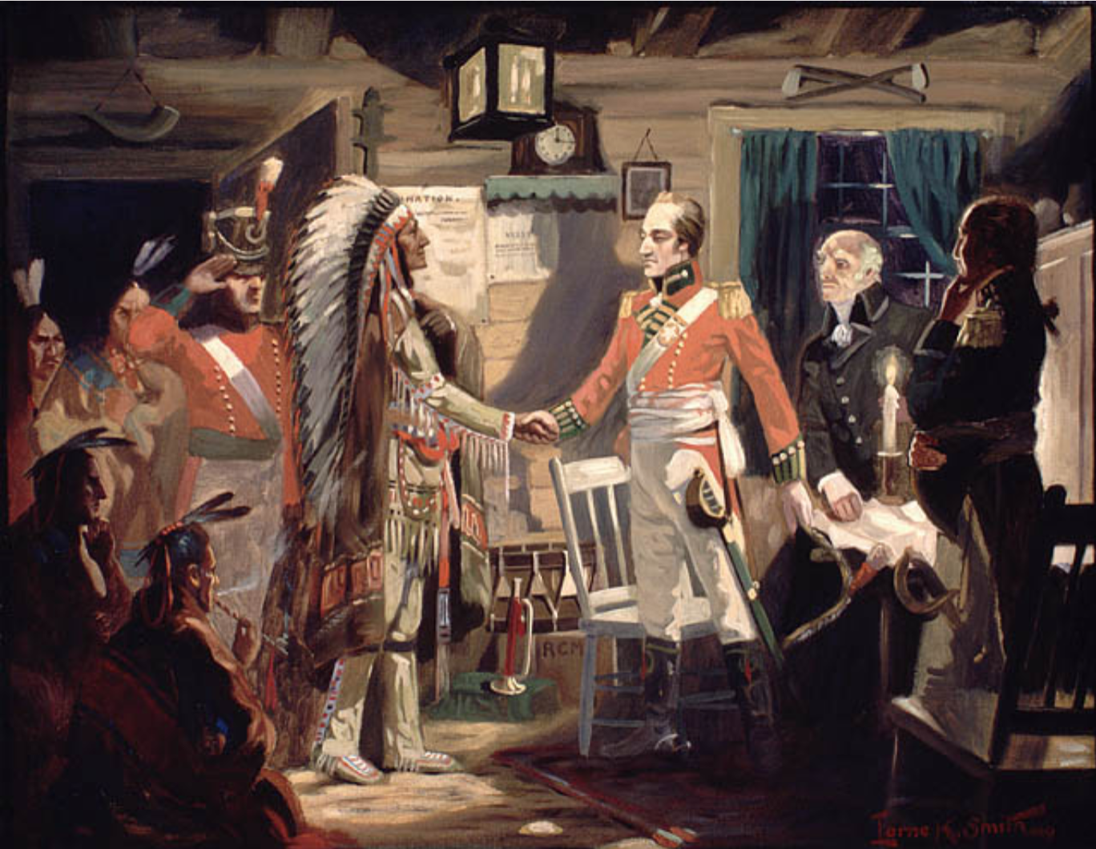
British Helping the Native Americans
Stifled trade with Europe caused tensions for Native Americans
Indigenous people resisted U.S. expansion
Native Americans formed an alliance with Britain
Britain armed the Native Americans
Native Americans resisted U.S. expansion
Britain encouraged attacks against the American frontier settlers
Notes:
Extra Resources:
"The Meeting of Brock and Tecumseh" painting https://recherche-collection-search.bac-lac.gc.ca/eng/home/record?app=fonandcol&IdNumber=2837232
As Europeans strove to gain more land and control on the American continent in the colonial period, Native Americans found ways to resist these European efforts — through diplomacy, war, or alliances — but struggled amidst new diseases, the slave trade, advanced weaponry, and a constant influx of European colonists. And as European nations rushed to stake their claims on already-inhabited land in the Americas, Native American nations carefully allied themselves with the European power they believed would give their people the best circumstances. For instance, during the French and Indian War of 1754-1763, the Iroquois Confederacy allied with the English while the Algonquian-speaking tribes joined forces with the French and the Spanish. Regardless of the English victory, aggression against Native Americans continued as Europeans continued to flock to the continent. As neighboring tribes had been pitted against each other through their claimed alliances with Europeans, rifts were built that kept tribes from uniting to halt the European advance. When American colonists rose up against the British Crown during the Revolutionary War, this conflict not only determined the future of the colonies — but also the future of the native peoples who lived in and around them. Again, tribes would be drawn into the conflict, forced to make difficult decisions about how and when to offer their support.
Possible discussion question: What were the advantages and disadvantages for the British from allying with the Native Americans?

Slide 10
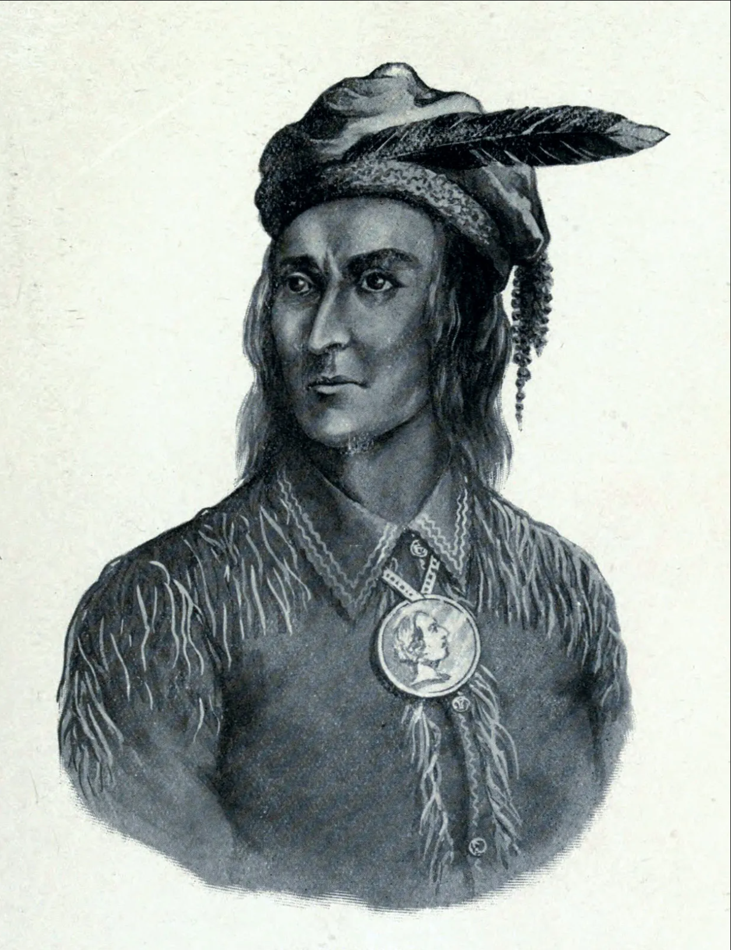
Tecumseh
William Henry Harrison
Notes:
Extra Resources:
Tecumseh biography https://www.battlefields.org/learn/biographies/tecumseh
Tecumseh portrait https://kids.britannica.com/kids/article/Tecumseh/353839
William Henry Harrison biography https://www.battlefields.org/learn/biographies/william-henry-harrison
William Henry Harrison portrait https://npg.si.edu/object/npg_NPG.96.201?destination=node/63231%3Fedan_local%3D1%26edan_q%3Dwilliam%252Bhenry%252Bharrison
Tecumseh
Tecumseh embodied a rare spirit of pan-Indian resistance. He and his brother, the prophet Tenskwatawa, founded Prophetstown as the center of their community. Tecumseh transitioned from military leader to political idealist and used his oratorial talent to attract volunteers from around Continental North America, regardless of language or tribal origin. With his encouragement, many Creeks began their own resistance movement called the Red Sticks, and waged their own war against the United States. Traditional leaders of the various tribes in the Great Lakes area had been encouraging peace and assimilation with the Americans, but Tecumseh argued that the U.S. had no claim to the Indiana territory. In 1811, Harrison defeated Tecumseh's forces at the Battle of Tippecanoe and destroyed Prophetstown, but this did not spell the end for the Shawnee leader. America went to war against the United Kingdom in 1812, at which point Tecumseh and the remnant of his forces struck a deal to support the British. He and his Confederacy fought alongside the British throughout the Great Lakes region. Despite his renewed efforts, he did not have a productive relationship with his British liaison, General Henry Procter. In 1813, Procter actually abandoned Tecumseh at the Battle of the Thames against his old enemy, Harrison. Tecumseh died in that battle, and with him any hopes of reviving his movement against further white settlement in the area. Despite his fervent anti-European beliefs, Tecumseh became something of a folk hero to both Native and white Americans.
William Henry Harrison
William Henry Harrison's father, Benjamin Harrison, was a prominent political figure and signer of the Declaration of Independence. He served in the U.S. Army what was then the Northwest frontier, present-day Great Lakes region. Harrison excelled while in the Army because of his sharp nature and attention to detail. He saw action at the Battle of Fallen Timbers in 1794, defeating the Shawnee, Delaware and Miami tribes. By age 28, in 1801 Harrison was the governor of Indiana. His administration focused on populating the recently vacated lands with American settlers. Harrison gained national fame following his defeat of Tenskwatawa and a Native American confederation at the Battle of Tippecanoe on November, 7 1811. He continued to improve his public image during the War of 1812 by leading successful campaigns against British and Native American forces in the northwest. During second attempt at a presidential campaign, the Whigs painted Harrison as a rugged frontiersman and Indian fighter--the image of a log cabin became synonymous with his presidential campaign. Harrison won the election of 1840 but had little time to impact the nation because upon his inauguration he contracted a cold and died of pneumonia a month later on April 4, 1841, the first commander in chief to die in office.
Possible discussion question: Why do you think Tecumseh's legend has persevered throughout American history?

Slide 11
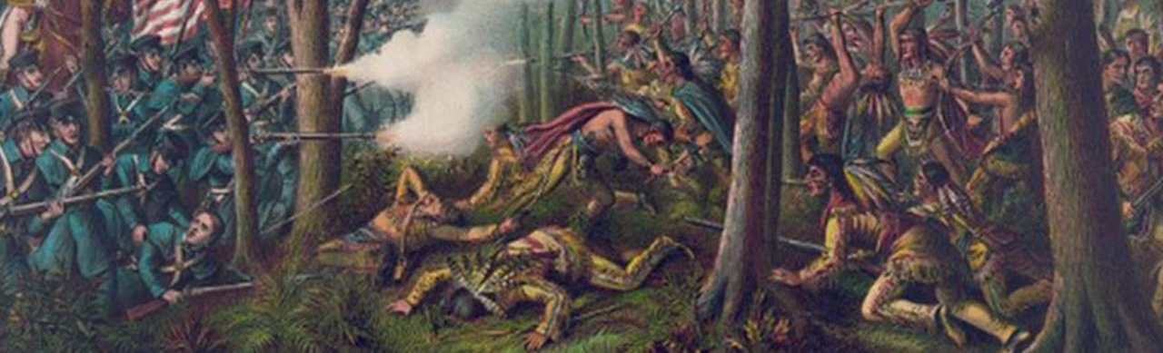
Battle of Tippecanoe
Shawnee chief Tecumseh and the prophet Tenskwatawa organized a Native American confederation to combat the horde of pioneers flooding into native lands
The organized resistance prompted Governor William Henry Harrison to lead roughly 1,000 soldiers and militiamen to destroy “Prophetstown,” the organized resistance
Harrison’s superior numbers and firepower held their positions and dispelled the warriors’ attacks.
The distrust for Tenskwatawa caused the Native Americans to immediately abandon Prophetstown, leaving it wide open for Harrison’s raid.
The defeat prompted Tecumseh to ally his remaining forces with Great Britain
November 7, 1811
Notes:
Extra Resources:
"Tippecanoe" article https://www.battlefields.org/learn/war-1812/battles/tippecanoe
"William Henry Harrison: Tippecanoe and Political Spin Too" article https://www.battlefields.org/learn/articles/william-henry-harrison-tippecanoe-and-political-spin-too
Tenskwatawa biography https://battlefields.org/learn/biographies/tenskwatawa
Following the Treaty of Fort Wayne, an 1809 agreement requiring Indiana tribes to sell three million acres of land to the United States government, a Shawnee chief named Tecumseh, organized a confederation of Native American tribes to combat the horde of pioneers flooding into native lands. The organized resistance prompted Governor William Henry Harrison to lead roughly 1,000 soldiers and militiamen to destroy the Shawnee village “Prophetstown,” named for Tecumseh’s brother Tenskwatawa, “the Prophet,” and designed by Tecumseh to be the heart of the new Native American confederacy. When Harrison arrived on the evening of November 6, 1811, he was met with a white flag by one of Tenskwatawa’s followers, who requested a cease fire. Harrison and his force of mostly militiamen had held their positions and dispelled the warriors’ attacks. Disheartened, the native warriors returned to Prophetstown and discredited Tenskwatawa’s leadership and the spells that he had cast to protect them. The distrust for Tenskwatawa caused the Native Americans to immediately abandon Prophetstown, leaving it wide open for Harrison’s raid. On November 8, 1811, Harrison torched Prophetstown and began his long march back to Vincennes. Tecumseh returned to Prophetstown three months after the battle only to find it in ruins. It was the end of his dream of a Native American confederacy. The defeat at Tippecanoe prompted Tecumseh to ally his remaining forces with Great Britain during the War of 1812, where they would play an integral role in the British military success in the Great Lakes region in the coming years.
Possible discussion question: How did the Battle of Tippecanoe exacerbate the conflicts that led to the War of 1812?

Slide 12
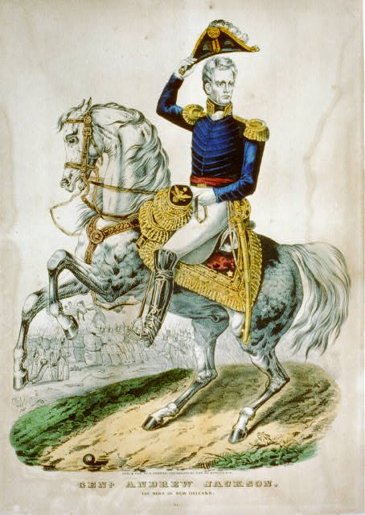
Andrew Jackson on Tecumseh
"That incendiary, the emissary of the Prophet, who is himself the tool of England, has caused our frontier to be stained with blood, and our peaceful citizens to fly in terror from their once happy abodes."
June 5, 1812
Notes:
Extra Resources:
Tecumseh's Promise regarding War and Peace primary source https://www.battlefields.org/learn/primary-sources/1812-tecumsehs-promise-regarding-peace-and-war
"Andrew Jackson to Willie Blount" primary source https://www.battlefields.org/learn/primary-sources/1812-a-terrible-vengeance
"Native American Involvement in the War of 1812" article https://www.battlefields.org/learn/articles/native-american-involvement-war-1812
"Genl. Andrew Jackson: the hero of New Orleans" illustration https://www.loc.gov/resource/cph.3b50295/
Andrew Jackson maintained a long history of anti-indigenous words and actions. As a major general, Jackson to led a force sent to suppress the Creek War of 1813. During his presidency, Jackson spearheaded and vehemently upheld the Indian Removal Act of 1830.
Possible discussion question: What can we interpret about one American perspective toward Native Americans by reading this quote?

Slide 13
The War Debate
War Hawks
Federalists
Supported war with Britain
Opposed war with Britain
Westerners and Southerners
New Englanders
Wanted westward expansion and acquisition of Florida and Canada
Wanted America to become an economic power based on manufacturing and trade
Wanted war because:
Did not want war because: they predicted economic disaster for New England if war ensued.
Notes:
Extra Resources:
"Warhawks vs. Federalists" article [link here]
"The Rise of Political Parties" article [link here]
[information here from "Warhawks vs. Federalists" article]
Possible discussion question: What similarities and differences do you between the War Hawks and the Federalists?

Slide 14
In Support of War
Against War
"War Against England"
"House Minority Response"
"We must strike or perish. The United States were compelled to “unbury the tomahawk,” or become colonies. We have solemnly determined on the former, and may God speed the cause."
"A war of invasion may invite a retort of invasion. When we visit the peaceable, and as to us innocent, colonies of Great Britain with the horrors of war, can we be assured that our own coasts will not be visited with like horrors?"
Date
Date
Notes:
Extra Resources:
"House Minority Response" primary source [link here]
"War against England" primary source [link here]
Possible discussion question: Do both of these arguments support the same inherent cause to protect American interests? Why or why not?

Slide 15
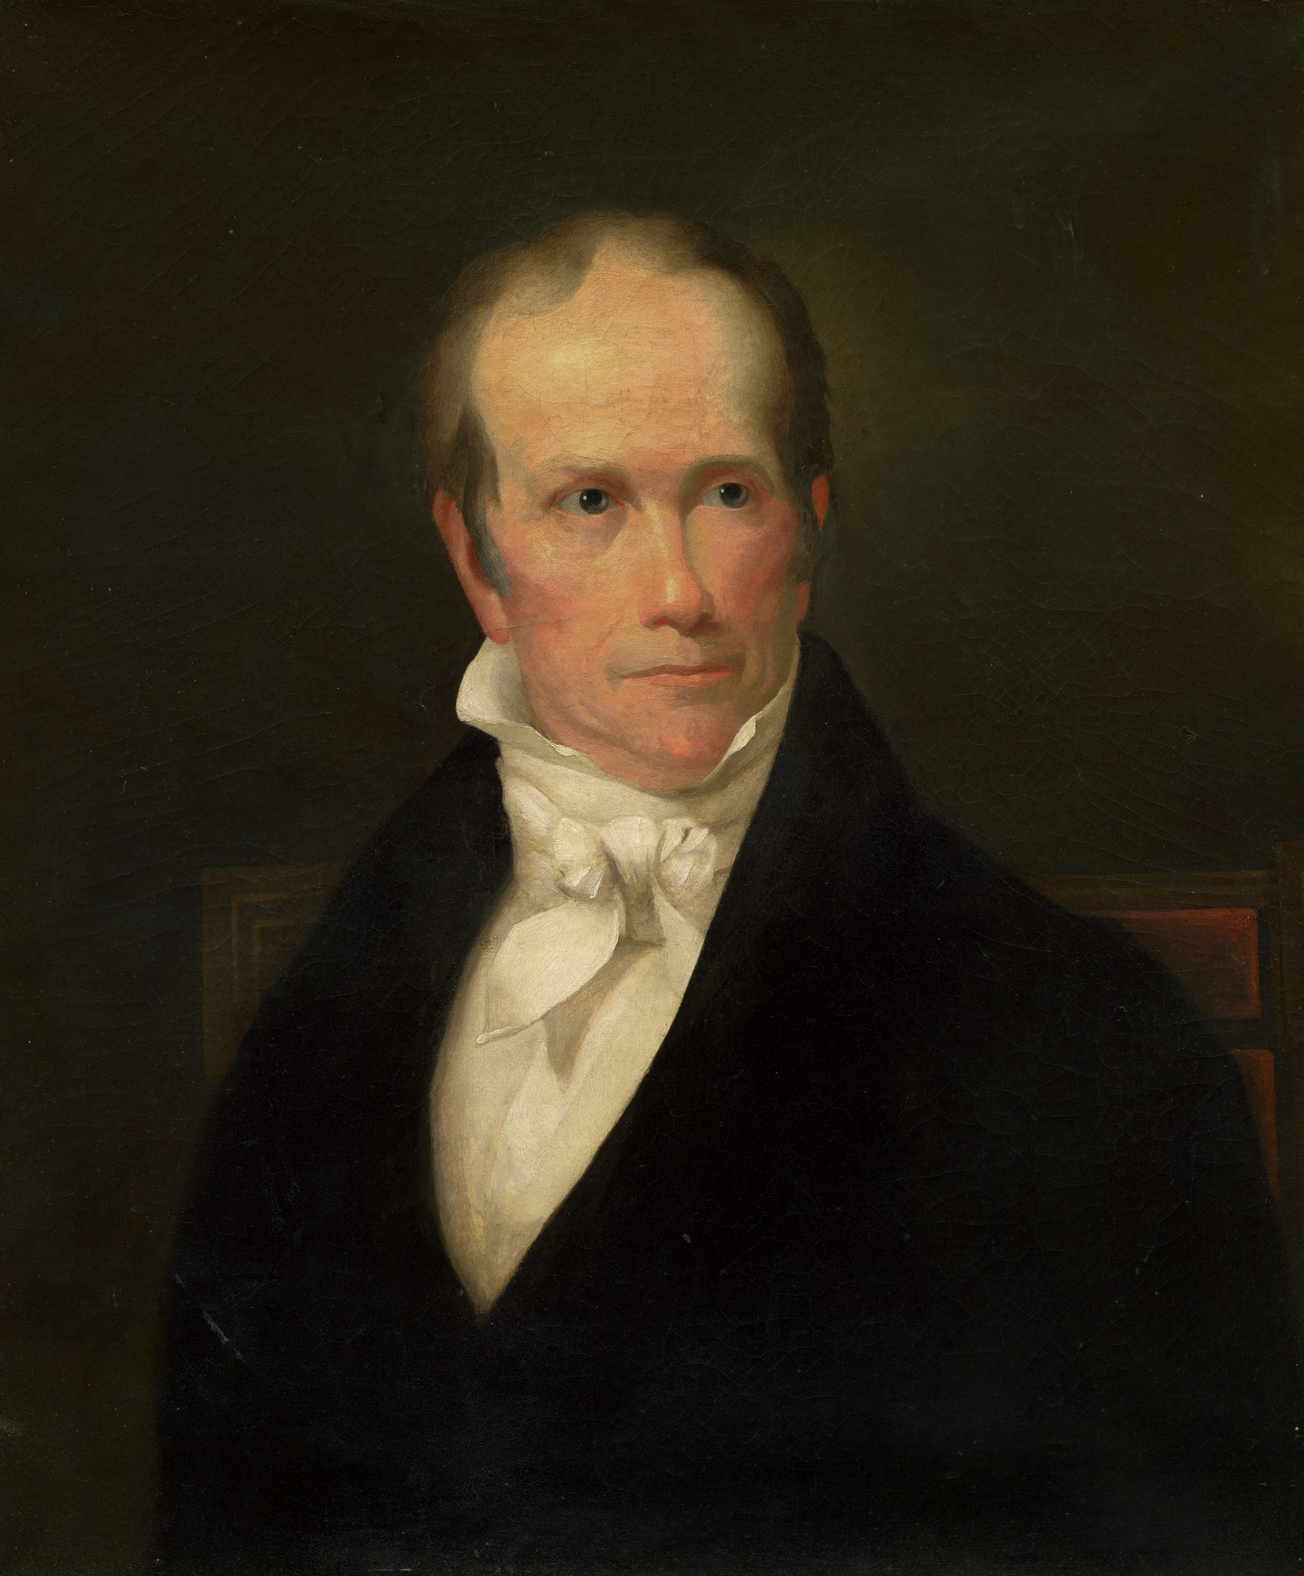
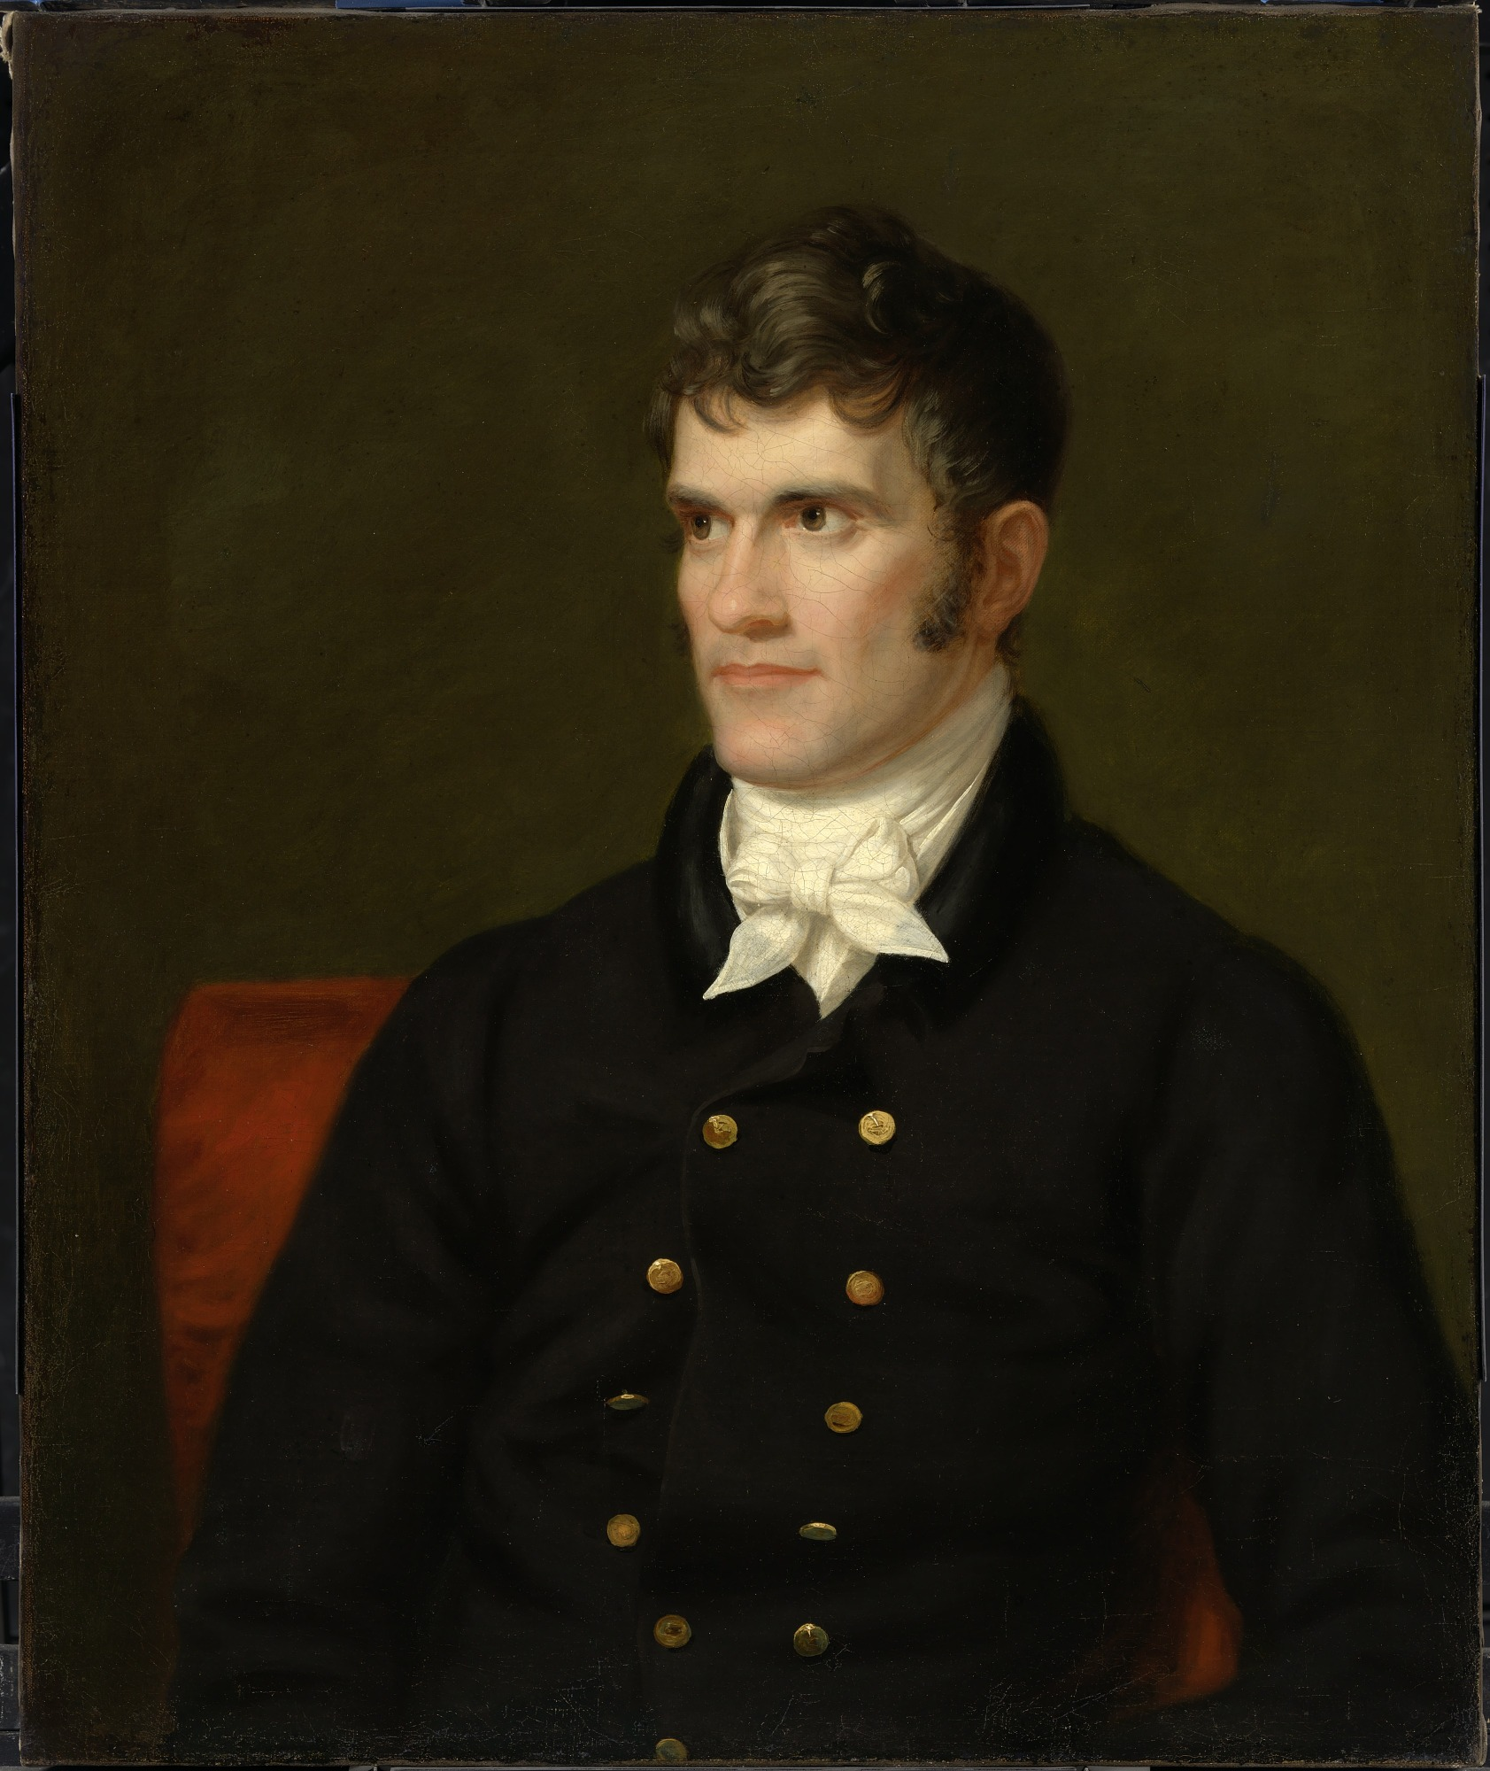
The War Hawks
Henry Clay
John C. Calhoun
Notes:
Extra Resources:
Henry Clay biography https://www.battlefields.org/learn/biographies/henry-clay
Henry Clay portrait https://npg.si.edu/object/npg_NPG.65.43?destination=node/63231%3Fedan_q%3Dhenry%2520clay
John C. Calhoun biography https://www.battlefields.org/learn/biographies/john-c-calhoun
John C. Calhoun portrait https://npg.si.edu/object/npg_NPG.65.58?destination=node/63231%3Fedan_local%3D1%26edan_q%3Djohn%252Bc%252Bcalhoun
Henry Clay
Although never President, Henry Clay dominated the American political landscape in the first half of the nineteenth century and remains one of the most influential men in Antebellum America. Clay maintained the reputation as "the Great Compromiser” throughout his career because he often favored and instigated compromise as opposed to the radical action that would propagate disunion. Clay remained a hardened nationalist throughout his entire political career. As a War Hawk, he actively encouraged war with Great Britain and supported the policies that provoked the War of 1812. Clay believed that economic prosperity required federal intervention in the economy. While Clay's plan, the American System, made headway in transportation networks, it also led to an economic crisis in early 1824. Clay’s final act of compromise was the Compromise of 1850 which alleviated tensions resulting from the Mexican Cession.
John C. Calhoun
John C. Calhoun served as one of the most influential politicians in the United States during the antebellum era, and his shifting political loyalties exemplifidthe politics of many Americans which changed as the United States grew increasingly sectional. Calhoun’s transition from a proud nationalist to an unequivocal defender of states’ rights and slavery began in the mid-1810s. In 1811, South Carolinians elected Calhoun to represent them in the United States House of Representatives. At this time, Calhoun was an ardent nationalist who supported Henry Clay’s American System, an economic plan that consisted of a high protective tariff, a large national bank, and a system of federally funded internal improvements funded by high taxes. Additionally, Calhoun denounced the British for their attacks on American ships and supported the embargo that led to the War of 1812. Calhoun himself was a War Hawk and fervently supported the War of 1812. Formerly a staunch nationalist, the "corrupt bargain" put Calhoun on the path to become the South’s most ardent defender of states’ rights. Calhoun did not trust the Democrats to protect slavery and southern rights.
Possible discussion question: In reference to these two figures, what do you think "sectionalism" means? Why is it important in this debate?

Slide 16
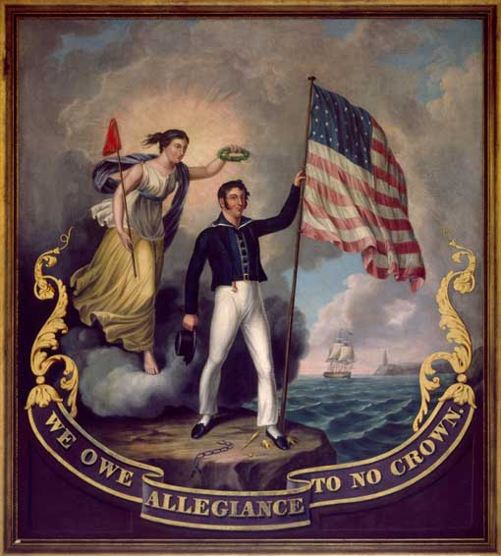
What Caused the War of 1812?
American territory expansion and deals with France
Britain's naval attacks against American sailors
Jefferson and Madison's trade restrictions
Indigenous-British alliances
Native American resistance of American westward expansion
Americans were pressured on all sides.
Madison's solution: War with Britain
Notes:
Extra Resources:
"We Owe Allegiance to No Crown" painting https://www.npg.si.edu/exhibit/1812/pop-ups/05-06.html
"President Madison's War Message" primary source https://www.battlefields.org/learn/primary-sources/james-madison-war-message-congress
"The War of 1812- An Overview" In 4 Minutes video https://www.battlefields.org/learn/videos/war-1812
Reinforce to students that there were wany causes of the war and many differing opinions about whether or not to go to war.
One cause was American territory expansion and deals with France. Napoleon used the Louisiana Purchase money to fund his European conquest efforts. This angered Britain and they subsequently declared war on France. Another cause was Britain's powerful navy attacking American ships and impressing American sailors for trading with France. Also, the French navy similarly harassed American ships for trading with Britain. Another cause was the American condemnation of Britain attacks in the forms of Jefferson's Embargo Act and Madison's continued suspicions against the British. Another cause was the tension from the lack of European trade stimulated Native American resistance of U.S. expansion, which led to indigenous alliances with Britain.
Possible discussion question: Why do you think there were so many causes that led to the War of 1812? Which causes do you think were most important, if any?

Slide 17
Notes:
Always more FREE resources at www.battlefields.org

