Slide 1
War of 1812: Conclusions
The War of 1812 Curriculum

Slide 2
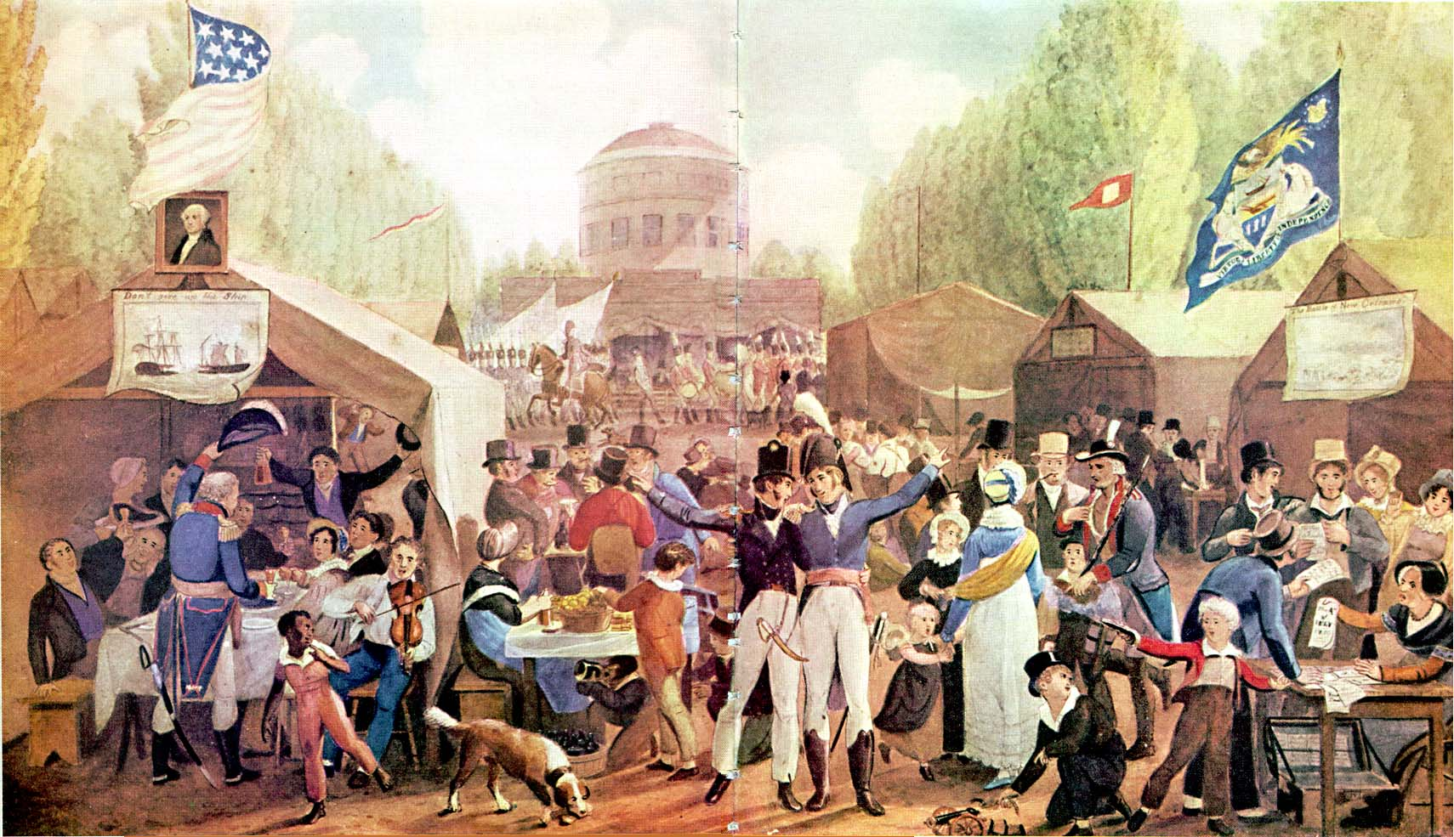
Essential Question
What were some of the outcomes of the War of 1812?
Notes:
Extra Resource:
Outcomes of the War of 1812: https://www.battlefields.org/learn/articles/outcomes-war-1812

Slide 3
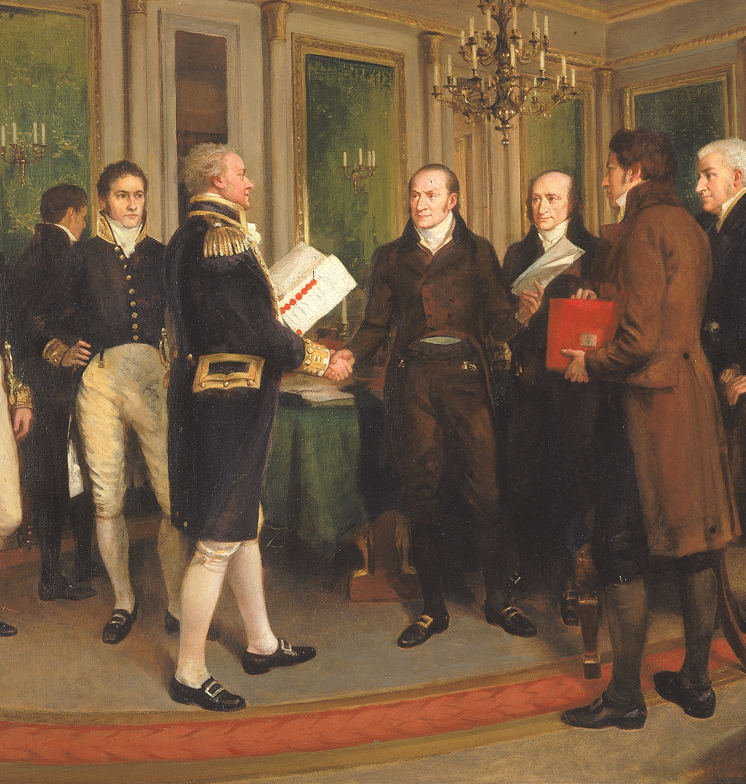
Treaty of Ghent
The peace treaty between the United States and Britain restored borders to the status quo antebellum.
The treaty was signed in the United Netherlands on December 24, 1814, but before word reached the forces in North America, the United States won a major victory at the Battle of New Orleans.
British impressment of American sailors was not explicitly mentioned, but the practice ended when the Napoleonic Wars did.
John Quincy Adams and Henry Clay were both present at the peace negotiations.
Status quo antebellum literally translates to "state before the war."
Notes:
Extra Resources:
Treaty of Ghent: https://www.battlefields.org/learn/articles/treaty-ghent-ending-war-1812
Treaty of Ghent (Video): https://www.battlefields.org/learn/videos/untold/treaty-ghent
Treaty of Ghent (Primary Source): https://www.battlefields.org/learn/primary-sources/treaty-ghent
After two years of war between the United States and Great Britain, the Treaty of Ghent was signed on Christmas Eve, 1814, and its terms hurried across the Atlantic for ratification by the U.S. Congress. Poor weather delayed the ship carrying the treaty, and before it arrived, the Americans won a major victory at New Orleans. The treaty was quickly approved by Congress, and peace was officially established on February 17, 1815. British-American borders were restored to the status quo antebellum, and the futures of both Canada and the United States were secured.

Slide 4
A New International Order
Trade increased between Britain and the United States, growing the American economy.
Without their British allies, Native American groups continued to lose territory and power to American expansion.
The United States was recognized as a world power which could compete with Europe.
Notes:
Extra Resource:
Outcomes of the War of 1812: https://www.battlefields.org/learn/articles/outcomes-war-1812
On the surface, it may seem that the War of 1812 was just pointless bloodshed spattered on the pages of human history. After all, according to the final Treaty of Ghent, all relations and borders were supposed to return to status quo ante bellum, or pre-war, status. Look beyond the legalism and into the practical effects of the war, however, and one will find significant attitudinal changes in the United States after the conflict, ushering in what most historians consider the “Era of Good Feelings” in the decade following the war.

Slide 5
Tecumseh's Confederacy
Nativist religious sects merged in the Purification movement, led by the spiritual leader Tenskwatawa.
Tenskwatawa's brother Tecumseh led the political side of the movement, uniting Native Americans from modern-day Ohio to Alabama against Anglo-American expansion. The confederacy allied with the British in the War of 1812.
After Tecumseh was killed and his forces defeated at the Battle of the Thames, the loose confederacy dissolved. Over the next century, most of the Native American land Tecumseh had fought for would be settled by whites.
Notes:
Extra Resources:
Tecumseh: https://www.battlefields.org/learn/biographies/tecumseh
Battle of the Thames: https://www.battlefields.org/learn/war-1812/battles/battle-thames
Native Americans and the War of 1812: https://www.battlefields.org/learn/articles/native-american-involvement-war-1812
No Good Feelings: Native Americans and the Outcomes of the War of 1812: https://www.battlefields.org/learn/articles/no-good-feelings-native-americans-and-outcomes-war-1812
While the self-reliant common man rose to a zenith, the same could not be said for the American Indian tribes of the frontier. With the end of the War of 1812, the Native Americans could no longer count on Great Britain to shield them from the flood of white settlers headed west. Settlers came in droves by the Erie Canal or through the Cumberland Gap. The next seventy-five years saw a rapid decline in the Native Americans' way of life, even for those tribes like the Cherokee or Choctaw that tried to adapt white ways of living. Manifest Destiny ruled the day.

Slide 6
Federalist Defeat
The Federalist Party, who steadily opposed involvement in the War of 1812, grew highly unpopular.
Especially criticized was the Hartford Convention, where Federalist leaders of New England states decided against secession.
Notes:
Extra Resources:
Hartford Convention: https://www.battlefields.org/learn/articles/hartford-convention
Federalist Party: https://www.battlefields.org/learn/articles/federalist-party
The biggest American casualty of the war was the Federalist Party, the first political party that had arisen in the United States. A party of bankers and businessmen, the Federalists' steady opposition to the war doomed them in the eyes of the American public. Their vociferous opposition to the commencement of the war, and their subsequent contemplation of outright secession at the "Hartford Convention," angered many Americans, who viewed the Federalists as “un-patriotic.” The Federalists had principally represented men of means and wealth, with the bulk of their membership in the Northeast. With the end of the war the party all but ceased to exist, and many of its former members rallied to new party banners, namely Republican and Whig, where they formed the political base for centralization, protectionism, and, eventually, abolitionism, in the latter half of the 19th century.

Slide 7
The Era of Good Feelings 1815-1820
With the collapse of the Federalist Party and the surge of American nationalism following the war, politics entered the "Era of Good Feelings."
Democratic-Republican James Monroe was elected president.
Monroe established a foreign policy, the Monroe Doctrine, which opposed European colonialism in the Americas.
Notes:
Extra Resources:
James Monroe: https://www.battlefields.org/learn/biographies/james-monroe
Era of Good Feelings: https://www.battlefields.org/learn/articles/era-good-feelings-jacksonian-age
Outcomes of the War of 1812: https://www.battlefields.org/learn/articles/outcomes-war-1812
A wave of national pride swept through the United States at the conclusion of the War of 1812 and the approval of the Treaty of Ghent in Congress in February 1815. The war had served to unite Americans, and they believed they had won a successful victory over the British, preserving their independence and national sovereignty. The lack of resolution of the war causes, the burning of the nation’s capital and the exposed weakness of the United States military system did not readily factor into the victory narrative.
The ending of the War of 1812 marked a brief period in United States History referred to as the “Era of Good Feelings”—a few years of prosperity, lessening of political division, and interest in projects for the national good. This proverbial calm before the storm preceded the Jacksonian Era which was characterized by the rise of new and powerful political parties, sectional interests, and increasing tension over slavery. These two eras set the stage for the more tumultuous decades of the 1840s and 1850s which pushed the country closer to the brink of civil war.

Slide 8
American Nationalism
The Battle of New Orleans was the war's most famous victory, and its anniversary was celebrated on January 8 as a national holiday.
"Natives of different states, acting together for the first time in this camp...have reaped the fruits of an honorable union." -Andrew Jackson
The War of 1812 was often celebrated as a second War of Independence.
Notes:
Extra Resources:
Era of Good Feelings: https://www.battlefields.org/learn/articles/era-good-feelings-jacksonian-age
From approximately 1815 to 1825, the United States turned inward, enjoying the feelings of victory, peace and prosperity in the first few years of the era. A Boston newspaper editor dubbed the period the “Era of Good Feelings” in July 1817. Other writers followed the trend with mixed seriousness and part sarcasm. “…The ecstasy of the bliss of the political Millennium and the era of good feelings,” chirped one newspaper later that year, proclaiming, “To the peaceable and the pious it must be truly delightful to trace the effusions, ‘the good feelings of a whole people.’”
Economic prosperity grew between 1815 and 1819, encouraged by a new protective tariff, the founding of the Second Bank of the United States, and new transportation networks linking regions of the nation. The Tariff of 1816 protected American manufactory from foreign competition and prevented raising certain taxes to reduce the federal deficit; the Tariff received rare support from the Southern states, partly because it did not significantly impact their imports and also because it was a temporary three-year tariff. The Second Bank of the United States built on Alexander Hamilton’s precedents and was chartered in 1816. It encouraged the expansion of credit while unable to regulate private banks, hold a large reserve, or set financial policy. Credit and land speculation in the west primed the American economy for a collapse. Rapid expansion into the Midwest and beyond the Mississippi River into the Louisiana Purchase—encouraged by the economy in the early years of the Era of Good Feelings—overlapped with intentional improvements for transportation between states and regions. The National Road, started in 1806, reached Wheeling, Virginia (West Virginia) in 1818 and plans were approved to extend this thoroughfare to St. Louis on the Mississippi River; the National Road set an example for other major construction projects across other regions. Canals, like the Erie Canal and Chesapeake & Ohio Canal, were started in this era and became valuable pathways for transporting agricultural crops.
Contributing to the “good feelings” was the perception of unified politics. The Federalist Party had dissolved, leaving the Democratic-Republican Party in control of state and national politics. Kentuckian politician Henry Clay championed “the American System” which formalized and politically encouraged the prosperous innovations. It focused on protective tariffs, high public land prices to create federal revenue, strengthening the Bank of the United States, and using tax and tariff revenue to build internal improvements. The strength of the American System’s concept offered something preferential to each region. Though ideal on paper, the system did not perform as equally as Clay and his supporters envisioned.
Protecting national interests fueled some of the diplomatic decisions and efforts during President James Monroe’s administration and the Era of Good Feelings. After years of wrangling and treaties, the land of Florida was officially added to the United States holdings through the Adams-Onis Treaty in 1821. The Monroe Doctrine, outlined in a message to Congress in December 1823, pledged to oppose European colonization in North and South America and would stay out of Old-World affairs in return. Admirers of the United States made significant visits during the peaceful years, including the Marquis de Lafayette, the last surviving major general of the Revolutionary War, who toured the country during 1824-1825.

Slide 9
The Star-Spangled Banner
The flag which inspired our national anthem was sewn by Mary Pickersgill, with the assistance of several other women, in 1813. It was commissioned by Major George Armistead, the commander of Fort McHenry in Baltimore harbor.
On September 14, 1814, Francis Scott Key witnessed the flag rise over Fort McHenry after a night of bombardment by British shells. The fort had not fallen and Baltimore would not be surrendered to the British. Key was inspired by the sight to write a poem, "The Defense of Fort M'Henry."
The poem's words were set to the tune of "To Anacreon to Heaven," the official song of an English music society, and the song became known as "The Star-Spangled Banner."
The song was adopted by Congress as the official national anthem in 1931, and the flag which inspired it is displayed in the National Museum of American History.
Notes:
Extra Resources:
A Short History of the Star-Spangled Banner: https://www.battlefields.org/learn/articles/star-spangled-banner
Mary Pickersgill: https://www.battlefields.org/learn/biographies/mary-young-pickersgill
George Armistead: https://www.battlefields.org/learn/biographies/george-armistead
Francis Scott Key: https://www.battlefields.org/learn/biographies/francis-scott-key
Primary Source – The Star-Spangled Banner: https://www.battlefields.org/learn/primary-sources/war-1812-star-spangled-banner
Star-Spangled Garrison Banner: https://www.battlefields.org/learn/articles/star-spangled-garrison-banner
Fort McHenry: https://www.battlefields.org/learn/war-1812/battles/fort-mchenry
Francis Scott Key wrote the “Star-Spangled Banner” as a joyous poem after he was relieved that the United States had preserved against British attack. Since then it has evolved into the national anthem for the United States and is played at official events, schools, and sporting events. This anthem is a means to bring Americans together to remember the United States' perseverance in the face of adversity and as a stage that Americans can use to protest unjust policies.

Slide 10
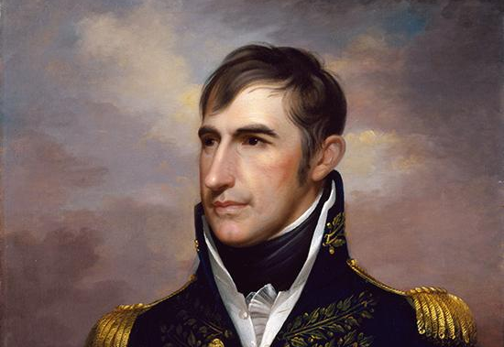
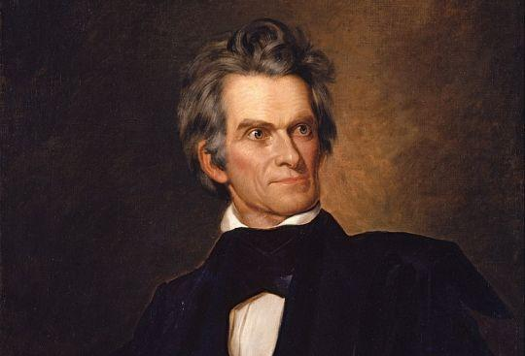
William Henry Harrison, hero of the Battle of the Thames, was elected president in 1840 on the Whig ticket.
John C. Calhoun of South Carolina was a nationalist who strongly supported the War of 1812, but gradually became a defender of states’ rights due to his support for slavery.
A new generation of political leaders emerged in the 1810s and 1820s.
Notes:
Extra Resources:
William Henry Harrison: https://www.battlefields.org/learn/biographies/william-henry-harrison
John C. Calhoun: https://www.battlefields.org/learn/biographies/john-c-calhoun

Slide 11
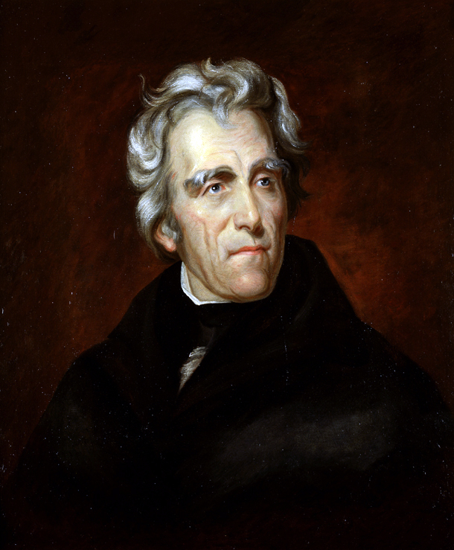
Andrew Jackson
The most famous military hero of the War of 1812 was Andrew Jackson, who defeated the British at the Battle of New Orleans.
The end of property requirements to vote in many states made possible Jackson’s election in 1828 and ushered in the “Age of the Common Man.”
As president, Jackson worked to strengthen the union despite growing sectionalism between North and South.
Jackson signed the Indian Removal Act in 1830, forcing tens of thousands of Native Americans to leave their homelands.
Richard Schlecht
Notes:
Extra Resources:
Andrew Jackson: https://www.battlefields.org/learn/biographies/andrew-jackson
Andrew Jackson: "Old Hickory" Adored and Despised: https://www.battlefields.org/learn/articles/andrew-jackson-old-hickory-adored-and-despised
The Era of Good Feelings and Jacksonian Age: https://www.battlefields.org/learn/articles/era-good-feelings-jacksonian-age
The election of Andrew Jackson as the seventh President ushered in the age of the “common man.” Jackson was the de facto hero of the common man and his policies as president reflected that fact. The election of Jackson in 1828 is also notable because of the shift in American political demographics. Suffrage became more widespread, as property requirements to vote were dropped by the states, resulting in a huge surge in the number of eligible voters.
While the self-reliant common man rose to a zenith, the same could not be said for the American Indian tribes of the frontier. With the end of the War of 1812, the Native Americans could no longer count on Great Britain to shield them from the flood of white settlers headed west. Settlers came in droves by the Erie Canal or through the Cumberland Gap. The next seventy-five years saw a rapid decline in the Native Americans' way of life, even for those tribes like the Cherokee or Choctaw that tried to adapt white ways of living. Manifest Destiny ruled the day.

Slide 12
Manifest Destiny
The defeat of Native American nations, the Monroe Doctrine, and peace with the British all contributed to a massive westward expansion.
The term “Manifest Destiny” came to represent the idea that westward expansion was justifiable, inevitable, and the unique birthright of the United States.
Notes:
Extra Resources:
Slavery and other Challenges of Westward Expansion: https://www.battlefields.org/learn/articles/slavery-and-other-domestic-challenges-western-expansion
Manifest Destiny called for the expansion of the United States from the Atlantic to the Pacific, often inserting religious justification into the political and social movement. While many Americans believed in Manifest Destiny, they divided on the specifics—debating if the new territories and states should be slave or free states. The Indian Removal Act of 1830 and the American interest in the Battle of the Alamo (1836) and Republic of Texas are some of the early, controversial outcomes of Manifest Destiny.

Slide 13
Slavery Expands
x
Thousands of American slaves gained their freedom during the war, often by fleeing to British-held areas.
In the Treaty of Ghent, Britain and the United States promised to work together to end the international slave trade.
Both the abolitionist movement and the defenders of slavery grew more vocal with the end of the war and the cotton boom.
In 1820, the Missouri Compromise set a precedent for the admission of free and slave states to the Union in pairs, maintaining sectional balance in Congress.
Notes:
Extra Resources:
Slavery and other Challenges of Westward Expansion: https://www.battlefields.org/learn/articles/slavery-and-other-domestic-challenges-western-expansion
Missouri Compromise: https://www.battlefields.org/learn/articles/missouri-compromise
Missouri Compromise Primary Source: https://www.battlefields.org/learn/primary-sources/missouri-compromise
Contemporary portrayals of the United States' Westward Expansion often painted the process as the inevitable march of progress. Sadly, many of the complications surrounding expansion proved to be milestones on the path to the American Civil War. As the borders moved westward, so did American settlers, which raised several serious questions over what certain Americans were bringing with them; particularly the slaves. Historians have often noted how the complications surrounding the acquisition of new territory exacerbated domestic sectional tensions within the country around several major economic and social issues, since both North and South saw the west as the place to guarantee their distinct and ultimately conflicting visions for the country. Despite multiple compromises to work around these issues, conflict inevitably came to a head as Southerners dug their heels in to defend the institution upon which they built their society from hindrance.

Slide 14
Conclusion
While the end of the War of 1812 led to an increase in American nationalism and new foreign and domestic policies, specific war aims were not achieved, and British-American borders were restored to the status quo antebellum.

Slide 15
Notes:
Always more FREE resources at www.battlefields.org

