Slide 1
1775 Perspectives: Lexington and Concord
A Revolutionary War Lesson Plan

Slide 2
Lexington & Concord in 4 Minutes
Notes:
YouTube Video Link: https://youtu.be/jQtkw2tCLyU?si=FAXZehj1gbOnornn
Website Video Link: https://www.battlefields.org/learn/videos/lexington-and-concord

Slide 3
Map of the British Advance
Notes:
Print copies and examine this map: https://www.battlefields.org/media/document/38397

Slide 4
Map of the British Retreat
Notes:
Print copies and examine this map: https://www.battlefields.org/learn/maps/battle-lexington-and-concord-british-retreat-april-18-19-1775

Slide 5
Massachusetts
Massachusetts Bay Colony was founded in 1630.
By the mid-1700’s, Massachusetts was one of the most prosperous colonies and had a busy seaport and capital at Boston.
Massachusetts became a center of resistance to British taxes. Boston was the scene of confrontations like the Boston Massacre (1770) and Boston Tea Party (1773).
The Sons of Liberty organized protests against British taxation and British soldiers sent to Boston.
In 1774 the Massachusetts Provincial Congress tried to seize control of the colony from the British Royal Governor. This Congress also asked local militia units to prepare to defend the colony’s weapons and supplies from the British soldiers.
Notes:
Learn more:
Boston Massacre: https://www.battlefields.org/learn/articles/boston-massacre
Boston Tea Party: https://www.battlefields.org/learn/topics/boston-tea-party
The British Army in Boston: https://www.battlefields.org/learn/articles/british-army-boston
Who were the Sons of Liberty?: https://www.battlefields.org/learn/articles/who-were-sons-liberty

Slide 6
The Mission
700 British soldiers left Boston, Massachusetts with orders to march to Concord and capture weapons stored there.
Expecting the British expedition and warned hours ahead of time, minutemen and militia from the local communities assembled, hoping to peacefully oppose the British advance and searches.
Notes:
Extra Resources:
Paul Revere, William Dawes, and Samuel Prescott had alerted the towns of Lexington and Concord early that morning with the reports that the “regulars,” term for British Redcoats, were on the march from Boston. The warning reached John Hancock and Samuel Adams in Lexington who escaped, as the belief of Dr. Joseph Warren, part of the Committee of Correspondence and still residing in Boston, and according to him the British Army may have marched out of Boston to seek their arrest.
The British contingent, under orders from General Thomas Gage, commander of His Majesty’s forces in Colonial America, consisted of light and grenadier companies, with Royal Marines, under the command of Lieutenant Colonel Francis Smith of the 10th Regiment of Foot and Major John Pitcairn of the marines as second-in-command. Their mission, which Gage hoped to be cloaked in secrecy, was to confiscate and destroy the military supplies secreted in Concord.

Slide 7
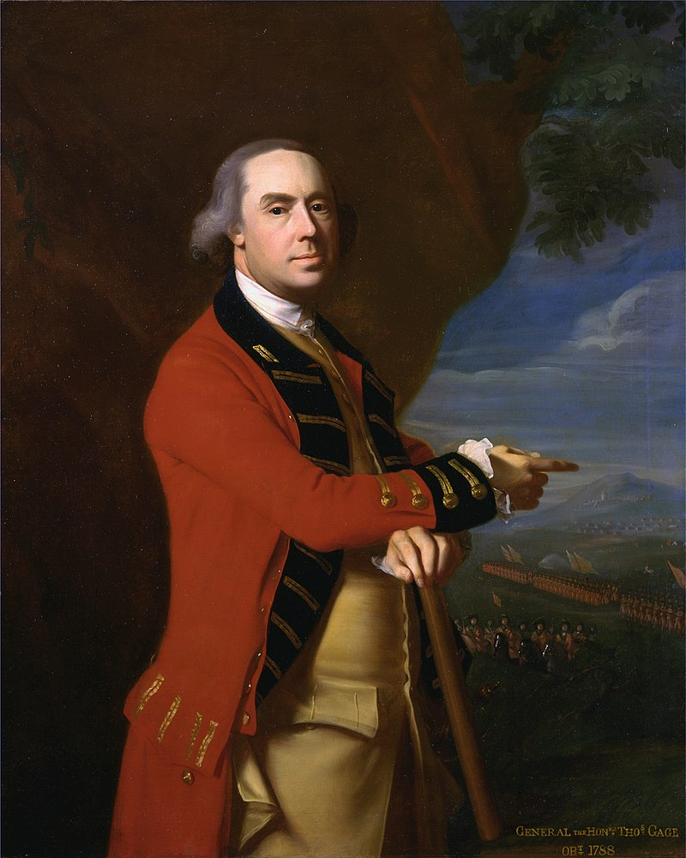
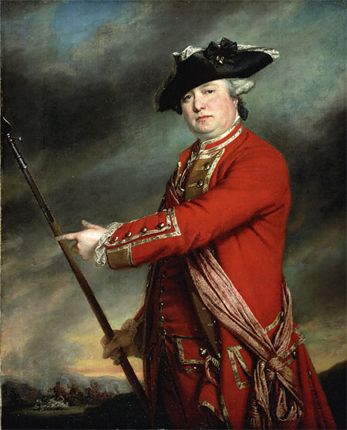
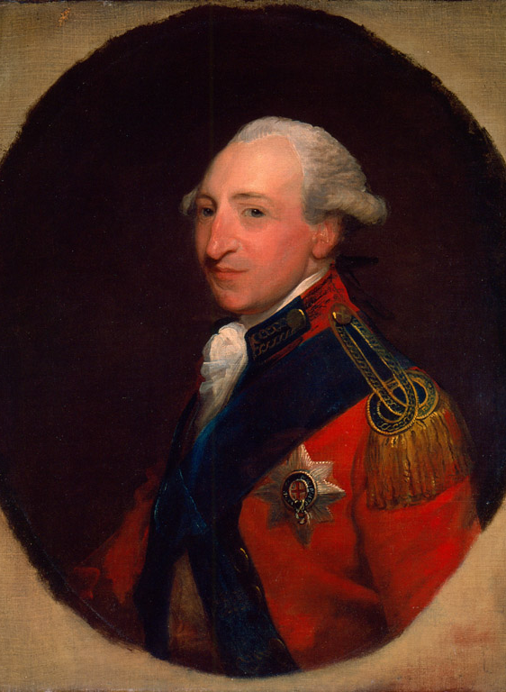
The British
General Thomas Gage commanded British troops in North America in spring 1775, and he gave orders for the expedition to Concord to seize weapons.
Colonel Francis Smith commanded the 700 British soldiers who left Boston and headed for Concord.
Major John Pitcairn led the advance troops in the British column on the march.
Colonel Hugh Percy commanded the reinforcements that met Smith’s troops at Lexington during their retreat from Concord.
(Left to Right: Gage, Smith, Pitcairn and Percy)
Notes:
Extra Resources:
Thomas Gage: https://www.battlefields.org/learn/biographies/thomas-gage
Francis Smith: https://www.battlefields.org/learn/biographies/francis-smith
John Pitcairn:
Hugh Percy: https://www.battlefields.org/learn/biographies/hugh-percy
The British Army during the American Revolution: https://www.battlefields.org/learn/articles/british-army-american-revolution
The events of April 19, 1775 were a culmination of many altercations between local militia and British Regular soldiers. On December 14 and 15, 1774, militia from Portsmouth, New Hampshire attacked Fort William and Mary. The British fort was undermanned (less than ten soldiers) but would not surrender to the militia force of nearly 300 men. Fighting ensued and one British soldier was wounded, the garrison surrendered and over the two days gunpowder, firearms and 16 cannon were captured. Though shots were exchanged from colonial militia and British Regulars, it did not lead to war.

Slide 8
Midnight Messengers
Paul Revere, William Dawes and Samuel Prescott carried the news of the British advance to Concord.
Other messengers took the news to other villages, rallying more militia units.
The midnight messengers completed their mission. The militia had been summoned to meet the British Regulars.
Notes:
Learn More:
Paul Revere’s Ride: Legends, Myths and Realities https://www.battlefields.org/learn/articles/paul-reveres-ride-legends-myths-and-realities
Paul Revere, William Dawes, and Samuel Prescott had alerted the towns of Lexington and Concord early that morning with the reports that the “regulars,” term for British Redcoats, were on the march from Boston. The warning reached John Hancock and Samuel Adams in Lexington who escaped, as the belief of Dr. Joseph Warren, part of the Committee of Correspondence and still residing in Boston, and according to him the British Army may have marched out of Boston to seek their arrest.

Slide 9
Militia & Minutemen
Militia units served as the backbone of protection in the colonies. They created a community bond that connected many far-flung neighbors. Most militias would muster and train in town and county centers, usually on court days. The events tended to have the air of a county festival, where entire communities came out to witness the drill and then host festivities afterward. Militias were the main colonial military organization for defense, but they were only part-time.
Minuteman companies were officially created by the Massachusetts Provincial Congress in October 1774 to be the best soldiers of each militia company. They regularly trained, and some were paid. They were to respond, “at a minute’s notice.”
Both Minutemen and Militia companies responded on April 19, 1775.
Notes:
Extra Resources:
Militia, Minutemen, and Continentals: The American Military Force in the American Revolution: https://www.battlefields.org/learn/articles/militia-minutemen-and-continentals-american-military-force-american-revolution
As events around Boston became more tense, many communities in Massachusetts began to create more elite companies of minutemen. Militias mostly trained on a seasonal basis, but minutemen companies were established to provide more regular training (sometimes weekly) of the best men in the militia. They were expected to respond quickly to danger at a “minute’s notice.” Some of the first minutemen companies were created in Worcester, Massachusetts, in September 1774. Soon, the Massachusetts Provincial Congress adopted this organizational structure for all Massachusetts militia units in October that same year. Other New England colonies began to do the same. Some of these units were in action on April 19, 1775, but contrary to popular thought, most of the colonial units that responded that day were not minutemen companies, but regular militia.

Slide 10
John Parker
A veteran of the French and Indian
Captain of the militia at Lexington, Massachusetts
Ordered his men to disperse in the morning of April 19, 1775, as the British arrived, but shots were fired at Lexington.
Organized an attack known as “Parker’s Revenge” on the British column as it retreated from Concord later in the day.
Notes:
Extra Resources:
https://www.battlefields.org/learn/biographies/john-parker
In April 1775, word arrived in Lexington that the British were marching from Boston to seize and or destroy Patriot military supplies at Concord. At this point, John Parker was forty-six years old, suffering from tuberculosis and on his death bed. On the morning of the April 19, he mustered his strength and walked two miles to Lexington Green to take command of the seventy or so militiamen awaiting the British regulars. Here, Parker is said to have told his men, “Stand your ground. Don’t fire unless fired upon, but if they mean to have a war, let it begin here.”
Nobody knew who fired the first shot of the American Revolution, but in the brief skirmish on Lexington Green, eight of Parker's men died (including his cousin Josiah) and another ten men fell wounded. The British column continued their march to Concord, did not find the supplies, and started marching back to Boston on the same road they left the city on. The Lexington militia under Parker regrouped along the road, hiding behind rocks and trees, ready to ambush the British column in what is called Parker’s Revenge. The Lexington militia fired in a single group of attacks along the road that would inflict heavy casualties on the British as they retreated.

Slide 11
Lexington: April 19, 1775 (Morning)
About 80 militiamen commanded by Captain John Parker waited on Lexington’s village green to present a show of force to the arriving British column.
Parker ordered his men to disperse when challenged by a British officer.
No one knows who fired the first shot, but it was followed by a British volley and then Americans returned fire.
When the confrontation was over, 8 militiamen had been killed and 10 wounded, and 1 British soldier had been wounded.
Notes:
Extra Resources:
10 Facts: Battles of Lexington and Concord: https://www.battlefields.org/learn/articles/10-facts-battles-lexington-and-concord
Buckman Tavern:
The Lexington militiamen that filed onto the Lexington Green the morning of April 19, 1775, were there as a show of force, to remind British authorities that the colonists were armed and ready to defend themselves. Much like other militia units had shadowed other British Regular excursions (most notably at Salem, Massachusetts on February 26, 1775), the Lexington militia had no intention in getting into a firefight with the Regulars. Captain John Parker proved to be a steady leader of the militia that morning, he knew it would be suicide for his 80 men to take on the 400 well-trained British Regulars. The position of Parker’s men to the side of the road to Concord show that Parker had no intention of blocking their route to Concord. Post war accounts of Parkers words that morning have been exaggerated, but his actions and primary accounts of those who were there prove that Parker had no intention of getting into a battle that morning.
One of the biggest mysteries of April 19, 1775, is who fired the first shot at Lexington. Both sides claimed the other side shot first, thus placing blame on their enemy for the bloodshed that ensued. It seems everyone interviewed after the events of April 19th had a varied answer to this question. It is obvious confusion and chaos infringed on everyone’s view of the events. There is evidence that points to either a quick trigger by one of the men on the Lexington green or a spectator firing from behind a stone wall near Buckman’s Tavern. We will never know who fired the first shot, but it was a spark that lit a world war.

Slide 12
Marching to Concord
Following the confrontation at Lexington, Smith ordered the British column to Concord to continue their mission.
Notes:
Order was restored soon after and with the arrival of the rest of Smith’s column, the light infantry fired a victory volley before resuming the march on to Concord.

Slide 13
James Barrett
A farmer who lived near Concord, Massachusetts
A veteran of the French and Indian War
Colonel of the militia near Concord
Barrett had been anticipating a British expedition to Concord and had already overseen the removal of the cannons and many of the other military supplies that the British wanted
On April 19, 1775, he commanded the arriving militia units and assembled them near Old North Bridge.
Notes:
Extra Resources:
James Barrett: https://www.battlefields.org/learn/biographies/james-barrett
Through a network of informants and midnight messengers word reached Concord in the early morning of April 19 that a British force had left Boston and was known to be heading for Concord to seize the cannons and other military supplies. Anticipating this, Barrett had already moved the cannons to Groton, a village nearly twenty miles away. He and the other farmers made sure the other military supplies were hidden. Barrett used pine boughs and garden furrows to conceal the supplies that remained on his property and left a few old gun carriages in his barn.
On April 19, 1775, approximately 700 British troops arrived in Concord. They had already met resistance from local militia at Lexington during their march and shots had been fired. Colonel Smith, commanding the British expedition, sent about 120 soldiers the additional two miles from the village of Concord to Barrett’s farm. Colonel Barrett was not there, having already joined the gathering militia companies. Mrs. Barrett met the British soldiers, told them they would not find military supplies on the farm, but gave them permission to search. The Redcoats found the old gun carriages but no cannon, and they missed the concealed supplies in the field furrows. Meanwhile, several officers asked Mrs. Barrett to make breakfast. She gave them food and refused pay, quoting her religious conviction to feed an enemy if he is hungry.
While the detachment of British soldiers searched Barrett’s farm and talked with Mrs. Barrett, the colonel and other militia officers moved to Old North Bridge, leaving the village in British hands for the moment. Eyewitnesses remembered that Colonel Barrett wore a leather miller’s apron over his worn clothing and carried a naval cutlass as he led the assembled farmers, innkeepers and tradesmen. He kept order and told the militiamen not to fire unless the British shot first.
Finding few supplies in Concord, more British soldiers were sent toward Old North Bridge and the Barrett Farm to join the contingent that had already been ordered there. However, this time Barrett and the other American officers opposed the British movements. Shots were fired at the bridge, and the British fell back. The sent-out groups of British soldiers rejoined their main body in Concord, and the expedition headed back toward Lexington and Boston, facing ambushes and fighting along the way.
James Barrett’s farm and leadership were at the center of fateful events in April 1775 as the American Revolution began.

Slide 14
Concord: April 19, 1775
Worried that the British were burning the village of Concord, Colonel Barrett ordered the assembled Massachusetts militia to advance toward Old North Bridge.
Shots were fired, and the fight at the bridge became known as the “Shot Heard ‘Round the World.”
Militia officers and men fell dead and wounded. The British soldiers retreated, rejoining the rest of their force in town.
Notes:
Extra Resources:
10 Facts: Battles of Lexington and Concord: https://www.battlefields.org/learn/articles/10-facts-battles-lexington-and-concord
The Shot Heard ‘Round The World: https://www.battlefields.org/learn/articles/shot-heard-round-world
With smoke wafting in the air, the Patriots feared that the British were burning the town in retribution for the gathering of military accouterments. Yet, in actuality, the smoke billowing was from a fire that was being suppressed. The British soldiers had stacked their arms and conducted a pail-brigade, handing buckets of water down the line, to extinguish flames that had jumped from a pile of artillery carriages being burnt to a residence in Concord.
As the commanders decided on a course of action, the men continued to murmur and gesture towards the smoke on the horizon. Captain William Smith of Lincoln, Massachusetts, voiced that his men were ready to evict the British from Concord. Isaac Davis, captain of militia from Acton, lent his voice in favor of a forward movement; “I haven’t a man who is afraid to go.”
Colonel Barrett, 64 years young that April day, turned to the men behind him on that hillside and ordered them to load their muskets. He implored the men to not fire first, but if fired upon, “to fire as fast as we could,” as was how one militiaman remembered. With these final preparations and instructions passed to the various units, Barrett led the men down the hill.
As the militia and minutemen tried to cover the open ground toward the North Bridge as quickly as possible, precision in battle line formation suffered. The British, seeing the advance, retreated to a position across the bridge on the town side.
This movement excited Major Buttrick, who believed their force could get across the bridge “If we were all of his mind he would drive them [the British] away from the bridge, they should not tear it up,” as he instructed the men around him. The men who heard him consented, in one unified voice. The minutemen from Acton, the only unit with bayonets and cartridge boxes, were in the lead at this juncture.
British Captain Laurie, in charge of the 115 men in the three companies, gave the command to move into “street firing” formation to allow for uninterrupted firing, as one row would fire, then melt to the flanks of the one behind, which would then fire, and do the same behind the third row, and so on until the field was taken or given up.
On came the militia, muskets held mostly at the trail in their left hands, the stocks barely above the ground. After descending the hill, the men’s route had consumed the curvature of the topography, reaching a causeway, and then headed east along the Concord River toward the North Bridge. Captain Laurie was still scrambling to get the three companies into the right formation, since, being from various units, the men had not worked with each other prior to being put together for this advance into the Massachusetts countryside.
And then, a musket discharge reverberated. Captain Laurie snapped his head around and noticed one of his men had fired. The now-famous “shot heard around the the world” had been discharged.
Two more British soldiers squeezed their triggers. These three shots were followed by a ragged volley from the front rank of redcoats. Though most of the rounds went high, a few of the rounds struck home. One instantly killed Captain Davis as a bullet pierced his chest. Private Abner Hosmer, an Acton minuteman, also died when a bullet penetrated his skull. The militia and minutemen were within 50 yards of the North Bridge.
Above the resounding din of the British muskets, Major Buttrick’s voice could be heard:
“Fire, fellow soldiers, for God’s sake fire!”
The order rippled through the ranks and the men halted, brought muskets to shoulders, and squeezed triggers. Bullets ripped through the British ranks, striking four officers and killing three privates and wounding five others. Pandemonium erupted in the British lines, and the men hastily retreated toward town.
As the action unfolded over the wooden span, the four companies that were dispatched to recover the military supplies headed back toward Concord. Colonel Barrett displayed his tactical adeptness by splitting his force in two, with the militia staying on the west side of the North Bridge and Major Buttrick leading the minutemen across the North Bridge to a defensive position. Proceeding out of the town were British reinforcements under Lieutenant Colonel Smith. One look at Buttrick’s minutemen manning the stonewall convinced the British commander to order a countermarch back to the town proper.
Coming from the other direction, Captain Parson’s command passed by the Massachusetts men, who remained eerily silent, guns ready, but not cocked. Upon the return of the British soldiers from Barrett’s homestead, Lt. Col. Smith ordered the entire British command back toward Boston, twenty-soon-to-be-hellish miles away.

Slide 15
The British Retreat
British soldiers retreated from the Old North Bridge.
Lt. Col. Smith ordered his troops to begin the retreat back toward Boston.
Massachusetts militiamen followed the retreating British, attacking them in ambushes along Battle Road.
Notes:
Lt. Col. Smith ordered the entire British command back toward Boston, twenty-soon-to-be-hellish miles away.
Thus, the “shot heard around the world” faded into the history books, as more shots, many more, would be fired in the ensuing hours as the British were harried back to the safety of the environs of Boston. Standing within view of the North Bridge was The Old Manse, constructed in 1770 for Reverend William Emerson, who witnessed the actions of April 19, 1775. His grandson, in 1837, the writer and poet, Ralph Waldo Emerson ended the first stanza of the “Concord Hymn” with the line:
“And fired the shot heard round the world.”
Although not uttered at the time of the engagement in April 1775, the “shot” marked the turning point of the fracas between the American Colonies and Great Britain. With shots fired, there was no turning back, and that evening the British found themselves trapped in Boston. Within months, George Washington, a Virginian, would be elected commander of the Continental Army. Six years and six months later, the British surrendered at Yorktown, Virginia, which marked the unofficial end of the American Revolution. Two years after that, the Treaty of Paris was signed between the two initial warring parties and American ally France.
The actions at Concord, at Lexington earlier that same day, and along the stretch of Massachusetts countryside now remembered simply as “Battle Road” were the “shots heard round the world” transitioned the war of words to one of bullets and the long trek to American independence.

Slide 16
Battle Road
As the British retreated the nearly 20 miles from Concord to Boston, Massachusetts militiamen fired on them.
The militia used walls, trees, and other cover along the road to hide and attack the British soldiers.
The road the British soldiers marched over became known as Battle Road.
Notes:
Nearly 130 colonial militiamen and Regulars were killed on April 19, 1775. The fighting along the “Battle Road” grew bloody as the Regulars marched from Concord towards Lexington and back to Boston. But the bloodiest and fiercest fighting took place in Menotomy (modern-day Arlington) along modern-day Massachusetts Avenue. Here the fighting became hand to hand and brutal. Harassed for miles, British soldiers began to go house to house clearing families from the buildings along the road. In the fighting in this stretch, nearly 25 colonists and 40 British regulars were killed, half the day’s death count.

Slide 17
Parker’s Revenge
Between the towns of Lincoln and Lexington, Captain Parker waited with his militia.
The militia ambushed the British in a fierce fight, driving them back to Lexington.
Notes:
Learn more:
Parker’s Revenge: https://www.battlefields.org/learn/articles/significance-parkers-revenge
The battle ground at “Parker’s Revenge” is one of the most important sites along the Battle Road, the route of the British retreat from Concord toward Boston on the afternoon of April 19, 1775. The British had failed to find a large quantity of arms at Concord. News of the British expedition and of the deaths of militiamen on the Lexington Green had spread across eastern Massachusetts. By noon, when the British began their march from Concord, the countryside was filled with angry militia companies.
As the British made their way from Concord back toward Lexington — about eight miles by a narrow road that wound past farms and pastures dotted with rocks and crossed by ditches and stone walls — American militia companies used country paths to intercept and ambush the enemy. A British ensign later wrote: “all the hills on each side of us were covered with rebels.” Americans fired on the British column at Merriam’s Corner, then at Brooks Hill, and a nameless turn in the road that became known as the Bloody Curve.
As the British column reached the line between the towns of Lincoln and Lexington, Capt. John Parker and his Lexington militia were waiting for them. Parker’s company included men who had fought that morning on Lexington Green. Some wore bandages stiffened from the blood of wounds they had suffered in the morning, and they were anxious to revenge themselves and their dead neighbors. Parker’s men confronted the British on a rocky hillside. Waiting until the British were close, they opened fire. The British were staggered, then charged the hill. Parker's men shot down several Regulars before retreating, and lost men of their own. Jedediah Munroe, who had been wounded on the Lexington Green at dawn, was killed.
At Parker's Revenge, the militia demonstrated the kind of courage and determination that sustained American soldiers through the eight years of the Revolutionary War. Parker’s men had been defeated that morning on the Lexington Green, but after the shock of that first battle, they had reorganized, and had waited bravely for the retreating British to renew the battle.

Slide 18
Percy’s Arrival
As the British soldiers retreated from Parker’s Attack, they arrived in Lexington.
Colonel Hugh Percy had led reinforcements from Boston and met Smith’s column near Lexington.
Notes:
Learn more:
Hugh Percy: https://www.battlefields.org/learn/biographies/hugh-percy
On April 19, 1775, a British expedition of about 700 soldiers headed toward Concord, ordered to seize weapons that American militia had near that village. The British soldiers encountered resistance, and shots were exchanged at Lexington and later at Concord. Colonel Francis Smith who commanded the expedition sent a message to Boston, asking for reinforcements. Hugh Percy marched more than one thousand soldiers to Lexington, meeting Smith’s troops who had been ambushed as they retreat from Concord. Percy’s hurried arrival with reinforcements and cannon protected Smith’s battered force, but the British retreat continued under attack and ambush from militiamen lining the road to the outskirts of Charlestown and Boston. After fighting back to safety, Percy gave the militia rebels respect, acknowledging they were organized in their resistance and fought well, using terrain to their advantage.

Slide 19
Fighting Back to Boston
The heaviest fighting of the day occurred between Lexington and Boston as the British retreat continued.
More and more militia companies joined the attacks.
When the British reached the cover of their ships’ guns near Charles Town and from Boston Harbor, the militia’s pursuit paused.
Notes:
The British conduct a running fight until they can reach the cover of British guns on ships anchored in the waterways surrounding Boston. The Patriots chase them but, having no clear orders, ultimately let them escape.
In the wake of Lexington and Concord, Governor Gage finds Boston faced by a huge militia of men who have arrived from throughout New England to fight for liberty. Numbering 20,000, this resolute force will become part of the Continental Army.

Slide 20
A World About to Change
By the end of the day, approximately 93 Americans had been killed, wounded or were missing. There were 300 British casualties.
Each side hurried to write about and portray the events of April 19 in ways that favored them and their cause.
The fighting on April 19, 1775, at Lexington and Concord marks the beginning of the American Revolution.
Though it was more than a year until the Declaration of Independence would be signed, the journey of revolution and new nation started along Battle Road.
Notes:
Learn more:
After the fighting ended at Lexington and Concord, the Massachusetts Provincial Congress began to take dispositions from those involved in the fighting on April 19, 1775. Colonial leaders were experts in public relations and knew that they needed to control the narrative of the events in Lexington and Concord if they were to succeed in a revolution. They believed that General Gage and the British military were the aggressors and agitators and knew it would be important to portray them as such as they attempted to gain other colonial support within North America. Dozens of these interviews were conducted in the days, weeks, and months after the fighting. Hundreds of pages of transcripts from these interviews are still available today. Likewise, albeit a little later, British authorities took dispositions from their soldiers as well. As the war progressed, both sides spent a lot less time getting testimonies from those involved in battles. These accounts after Lexington and Concord from both sides gives historians a great insight into the events of April 19, 1775, in an otherwise under documented period of history.

Slide 21
Primary Sources
A Deposition of Colonial Militiamen from the Battle of Lexington and Concord
"I Heard The Guns"
Loyalist Woman's Account of Lexington and Concord
"Several Letters Arrived at New-York, dated April 21, 1775"
"Describing the Events that Took Place at Lexington and Concord“
The American Crisis (1775)
Notes:
View the Lesson Plan Teaching Guide for links to these Primary Sources, worksheets, and discussion suggestions.

Slide 22
Notes:
Always more FREE resources at www.battlefields.org

