Slide 1
Not United
The American Battlefield Trust

Slide 2
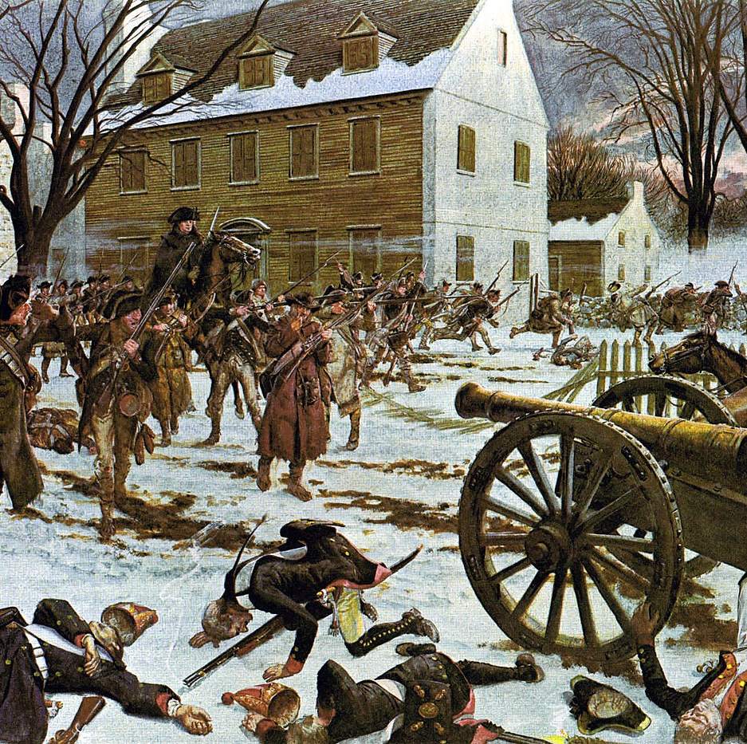
Previous Events
The Revolutionary War was fought between 1775-1783.
The United States declared independence from Britian in 1776.
The Treaty of Paris (1783) ended the war and secured American independence.
Notes:
American Revolution Timeline: https://www.battlefields.org/learn/articles/american-revolution-timeline
Declaration of Independence (Primary Source): https://www.battlefields.org/learn/primary-sources/declaration-independence
Declaration of Independence (Article): https://www.battlefields.org/learn/articles/declaration-independence
Treaty of Paris: https://www.battlefields.org/learn/articles/treaty-paris

Slide 3
Inquiry Question:
What difficulties did Americans face in the 1780s because of their government under the Articles of Confederation?
Notes:
An inquiry question to use in this lesson plan.

Slide 4
The Articles of Confederation
Notes:
The video is embedded in the slide, but here's a link: https://www.battlefields.org/learn/videos/untold/articles-confederation

Slide 5
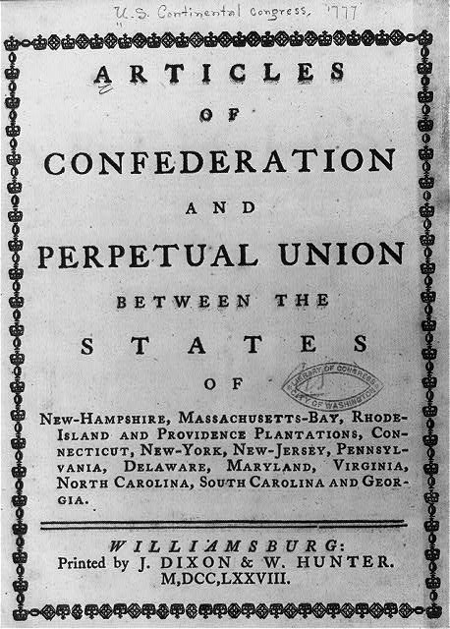
Articles of Confederation 1781-1789
The Second Continental Congress drafted the Articles of Confederation in 1777, providing a form of government, but they were not approved and in use until 1781.
Definition: Confederation — “an organization which consists of a number of parties or groups united in an alliance or league”
The Articles of Confederation established a Congress as the only governing body; that congress had limited powers and most government power stayed with the states.
Under the Articles of Confederation, interstate commerce, taxation, foreign policy and projects for the good of the nation were difficult to support or achieve.
Notes:
Articles of Confederation (Article): https://www.battlefields.org/learn/articles/articles-confederation
Articles of Confederation (Primary Source): https://www.battlefields.org/learn/primary-sources/articles-confederation
The Articles, in general, gave limited power to the central government. Congress could sign treaties and alliances with foreign nations; could regulate post offices, appoint officers in the military, and regulate armed forces; could request requisitions from the states; and could do other administrative functions. Congress could not declare war or peace with other nations without the consent of a super-majority of the states; could not levy taxes on states; could not require states send soldiers to fight in a national army; and could not interfere with state’s sovereignty. Congress was granted only the power that Great Britain had previously held over the Thirteen Colonies before the Intolerable Acts were issued. These limits were deliberate. The United States was reluctant to establish a strong central government while fighting a war against the ideas of “tyranny.”
The shortcomings of the Articles of the Confederation impeded the United States from properly governing the new country. The Treaty of Paris, which officially ended the conflict between the United States and Great Britain, was signed by delegates of the United States and Great Britain in Paris on September 3, 1783. However, the United States didn’t officially approve this treaty for another year as state delegates missed Congressional meetings. Quorum, the minimum number of delegates needed to proceed with Congressional meetings, was routinely not reached in order to approve the Treaty. These absences impacted Congress’s ability to pass any legislation. In addition to lacking the ability to force state delegates to attend Congress meetings, Congress lacked the ability to raise money to pay the veterans of the Revolutionary War. This procedural stall in payment resulted in Shays’ Rebellion, the name for numerous small rebellions that came to a peak on January 25, 1787. On that day, four thousand veterans, led by Daniel Shays, attempted to seize weapons from the Springfield Armory in Springfield, Massachusetts to protest lack of veteran payments and excessive taxation. Congress, unable to allocate money toward national troops, relied on the Massachusetts state militia and private militias to quell the rebellion. Even though the rebellion was quelled, Congress was powerless to provide solutions for the farmers’ qualms. On a foreign front, the United States was unable to secure treaties with foreign nations. With little ability to control individual state actions, foreign representatives in Europe could not guarantee compliance with potential treaties. Without these guarantees, foreign governments were reticent to trade the budding nation or strengthen the nation with political friendships.

Slide 6
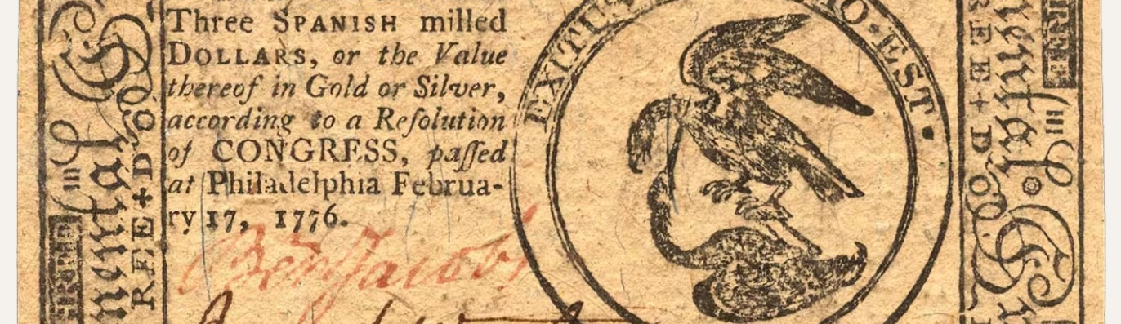
Economic Depression
During the American Revolution, the new nation received large loans from France and The Netherlands; payments on those loans started in 1785.
The separation from Britain closed trading opportunities with Britain and its empire until new trade treaties could be negotiated.
Inflation of Continental Currency, limited coinage and few banks added to economic difficulties.
The economic depression of 1780s and the restriction of commerce between states made life difficult for citizens, many of whom had lost or sacrificed much during the Revolution.
Notes:
Financing independence proved a costly endeavor. Declaring independence from a merchant mother country with world-recognized credit was a bold economic venture. After the challenges of financing a revolution and winning a war, the United States found itself in debt, in an economic depression and without national governance to address the challenges. The Articles of Confederation gave little power to the governing congress to tax, negotiate or unify the states’ efforts toward economic goals.
Read more: https://www.battlefields.org/learn/articles/economic-difficulties-1780s

Slide 7
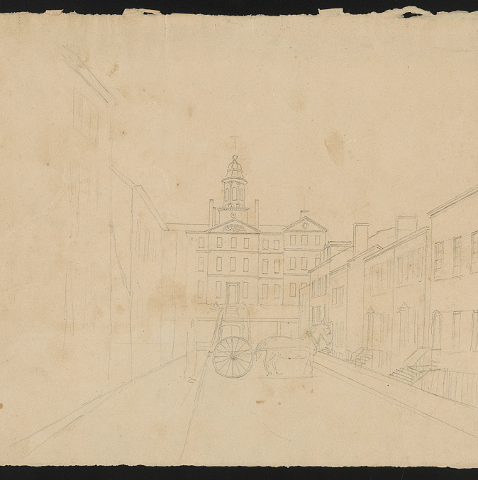
Interstate Commerce
States did not have guidance or assistance for setting up or regulating interstate commerce (doing business in different states.)
Neighboring states squabbled over rights to waterways used for transportation or over state import taxes.
The difficulties added to the economic depression by limiting opportunities.
Under the Articles of Confederation, Congress could do little to direct or assist.
Notes:
https://www.battlefields.org/learn/articles/boston-teapot-tonight
Due to the Governor of Massachusetts's (Hutchinson) refusal to let the ships return to England without payment of duties, and the colonists' adamant rejection of the tea, the vessels were trapped in the harbor. Interestingly, Hutchinson's decision illustrated his frustration with those who had rejected Royal authority over the years. Furthermore, the Tea Act was a way for Britain to flex its power over the colonies and force submission which Hutchison was not against. Many colonists simply wanted to resist the Tea Act peacefully and send the tea back to England. Nevertheless, with Hutchison's decision, many brave men decided that overtaking the ships and casting the tea into the harbor was their only option.

Slide 8
Mount Vernon Conference & Annapolis Convention
Statesmen from Virginia and Maryland met at Mount Vernon (George Washington’s home) in 1785 and reached an agreement about trade on their shared waterways.
The Annapolis Convention in 1786 wanted all the states to discuss interstate commerce, but few states sent delegates.
These meetings spotlighted the problems with the Articles of Confederation and the challenges and successes when states cooperated for common good.
Notes:
The Mount Vernon Conference and Annapolis Convention spotlighted the difficulties for states and government under the Articles of Confederation and became the launch points for the Philadelphia Convention, now better known as the Constitutional Convention. Growing from economic difficulties and conflicts over interstate commerce, these gatherings tried to solve immediate problems but ultimately revealed the greater challenges facing the fledgling nation politically and economically.
Learn more: https://www.battlefields.org/learn/articles/mount-vernon-conference-annapolis-convention
Image: Mount Vernon, Library of Congress https://www.loc.gov/item/2011660288/

Slide 9
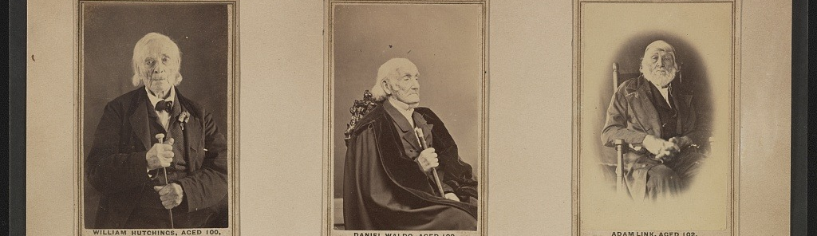
Revolutionary War Veterans
During the Revolutionary War, many soldiers did not receive their promised pay; after the American victory, they still did not get paid or receive land that had been promised to them.
It took decades for Congress to financially recognize and pay Revolutionary War veterans.
Meanwhile, the economic depression of the 1780s made it difficult for returning veterans to provide for their family and restore their businesses or farms.
(Some Revolutionary War veterans lived until the mid-19th Century — long enough to have their photographs taken.)
Notes:
Learn more: https://www.battlefields.org/learn/articles/revolutionary-war-veterans
Joseph Plumb Martin, whose diary is often quoted to get a glimpse of the common soldier’s experience, wrote this about the end of his service: “When the country had drained the last drop of service it could screw out of the poor soldiers, they were turned adrift like old worn out horses, and nothing said about land to pasture them upon.”
Although Martin’s very descriptive memory is not entirely accurate, the picture was bleak. Daniel Shays, whose surname gave title to one of the most famous rebellions of the early American republic, (Shays' Rebellion) is another testament to the experience of returning veterans. Shays received a court summons for unpaid debts, but he could not pay his bills and expenses because he had not received his military pay during or after the war. Many veterans sold the promissory notes at a mere fraction of their worth, just to buy essentials. This left little to no money for rent or loan payments. This resulted in the veterans’ taking matters of recourse into their own hands—like Shays who led a revolt in 1786 and 1787 in Massachusetts.

Slide 10
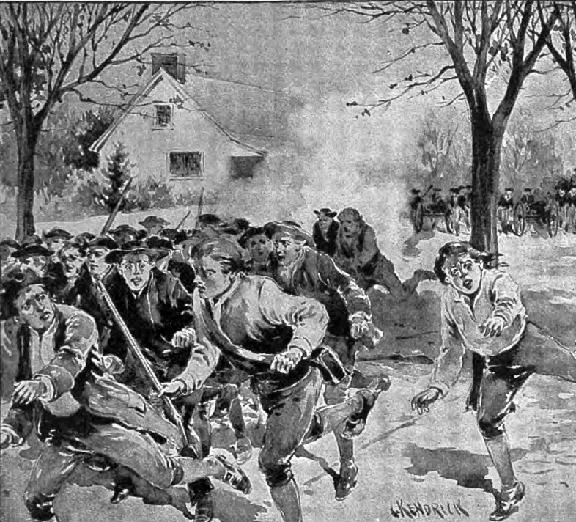
Shays’ Rebellion
Under the Articles of Confederation, Congress asked the states to help collect taxes to repay the outstanding loans.
As states raised taxes, farmers in Western Massachusetts rebelled, protesting the new taxes.
Daniel Shays—a veteran of the Revolutionary War—was one of the leaders of the unsuccessful movement.
This armed conflict led to widespread concern about the future of the United States and came at a time when many were considering the need to revise the Articles of Confederation for better government.
Notes:
Shays’ Rebellion (Article): https://www.battlefields.org/learn/articles/shays-rebellion
Daniel Shays: https://www.battlefields.org/learn/biographies/daniel-shays
Shays’ Rebellion left many people calling for reforms to the government of the United States. This desire to make the federal government more functional and responsive to the needs of the people culminated at the Philadelphia Convention of 1787. While the Convention was called with the stated purpose of amending the Articles of Confederation, its delegates instead created an entirely new foundational document, with a new structure of government: the Constitution of the United States.

Slide 11
Shays’ Rebellion: A Revolt Against The Revolution
Notes:
The video is embedded in the slide, but here's a link: https://www.battlefields.org/learn/videos/untold/shays-rebellion-revolt-against-revolution

Slide 12
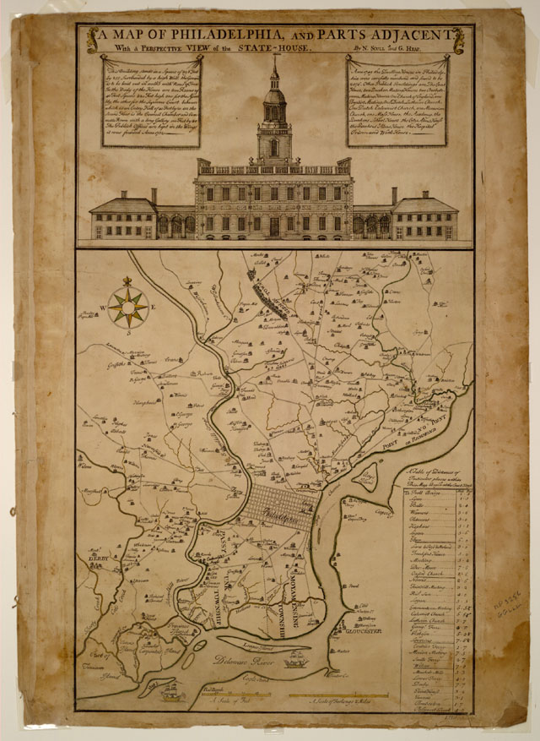
Unite? Revise?
As delegates prepared for the Philadelphia Convention in 1787, many agreed it was time to revise the Articles of Confederation.
The economic difficulties, conflicts between states and Shays’ Rebellion—among other issues—highlighted that the states were not united; it was difficult to work together for national good under the Articles of Confederation.
Questions of government power, state power and national unity loomed as the political and social conflicts of the day made it clear: something had to change.
Notes:
With a list of grievances growing, Congress began deliberations to write a new guiding document. This new document was the Constitution of the United States, the guiding document of the United States to this day. On September 28, 1787, the new Constitution was presented to Congress. Within a year, the Constitution had been ratified by all Thirteen States. On March 4, 1789, the Constitution was officially effective as rule of law in the United States and the Articles of Confederation was retired. While the Articles of Confederation was not inherently bad or ill-advised, it wasn’t the appropriate governing document for the United States. At the States became an independent nation and transitioned from wartime to peace, Congress recognized the strengths and the weakness of the Articles. Learning from their experiences, Congress used the Articles of Confederation as a steppingstone creating a productive government for their budding nation.

