Slide 1
The Federalist Era
The American Battlefield Trust

Slide 2
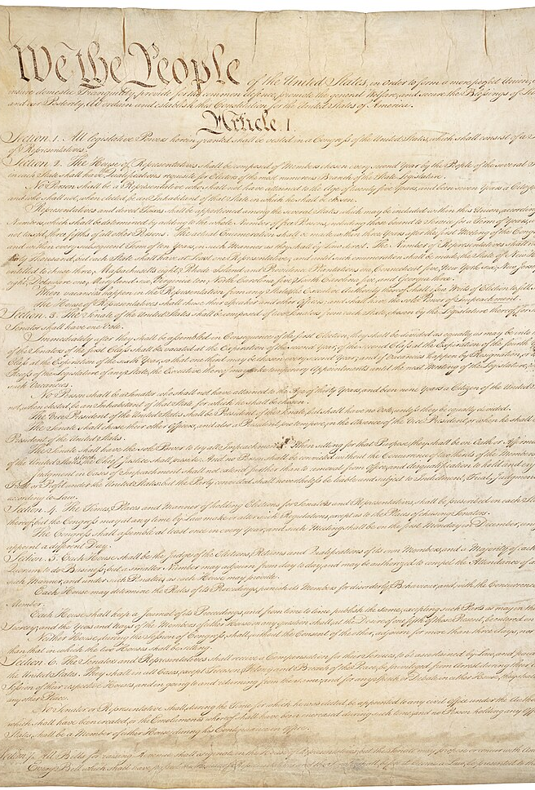
The Constitution
Drafted at the Constitutional Convention in 1787.
Ratified by the states in 1788.
Replaced the Articles of Confederation.
The United States adopted a federal democratic-republic form of government, as outlined in the Constitution.
Elections were held and in 1789 the first president, the House and Senate of Congress, and the Supreme Court justices were ready to take office and begin governing.
Notes:
The Constitution of the United States: https://www.battlefields.org/learn/primary-sources/constitution-united-states
Forms of Government: https://www.battlefields.org/learn/articles/forms-government
By mid-September 1787 as the final draft of the Constitution of the United States took shape, the debates and decisions had led to a federal government with internal and external checks and balances to help distribute and limit governmental powers. Webster defined “Federal” as “Consisting in a compact between parties, particularly and chiefly between states or nations; founded on alliance by contract or mutual agreement; as a federal government, such as that of the United States.” With a stronger central government than a confederacy but with limits to that centralized power outlined by a governing document, the United States adopted the form of a federal democratic-republic form of government outlined in a constitution.
Governing authority was divided between three branches of government: legislative, executive and judicial. Each balancing and countering each other. The legislature (Congress) would be bicameral (two houses) with a Senate and a House. In the House, the representatives from the states would be elected by the people and each state would have representatives based on the population of the state. In the Senate, each state—regardless of size or population—would have two senators, elected by the state’s legislature. (In 1913, the 17th Amendment to the Constitution was ratified, allowing for direct election of senators.) The Bill of Rights—the first ten amendments added to the Constitution and ratified in 1791—emphasized and protected the rights of Americans and that specifically stated that powers not given in the Constitution would remain with the states.
The Constitution of the United States tries to protect the voice of the people and creates a system of checks and balances to limit the power of the federal government. The delegates to the Philadelphia Convention shifted their goal from revising the Articles of Confederation to creating something new. They drafted a document that combined the ideas of republics, the voices of democracy and the limits to try to prevent future tyranny.

Slide 3
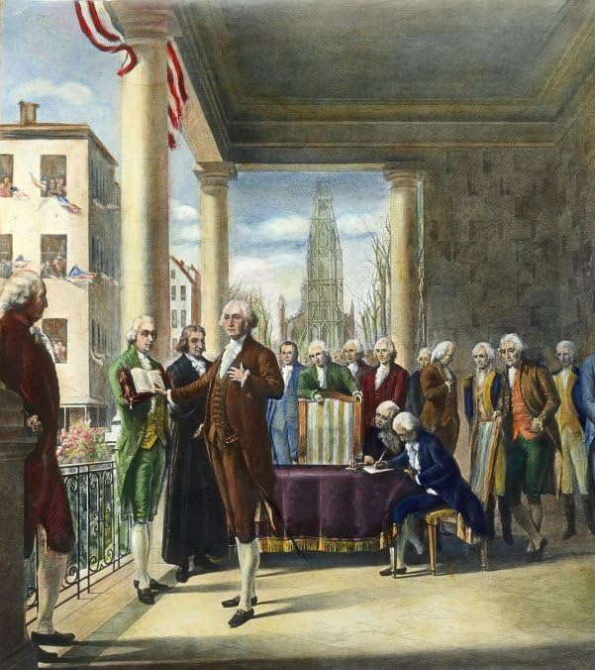
Inquiry Question:
What were some of the challenges and successes in the first decade of governing under the Constitution of the United States?
Notes:
An inquiry question to use in this lesson plan.

Slide 4
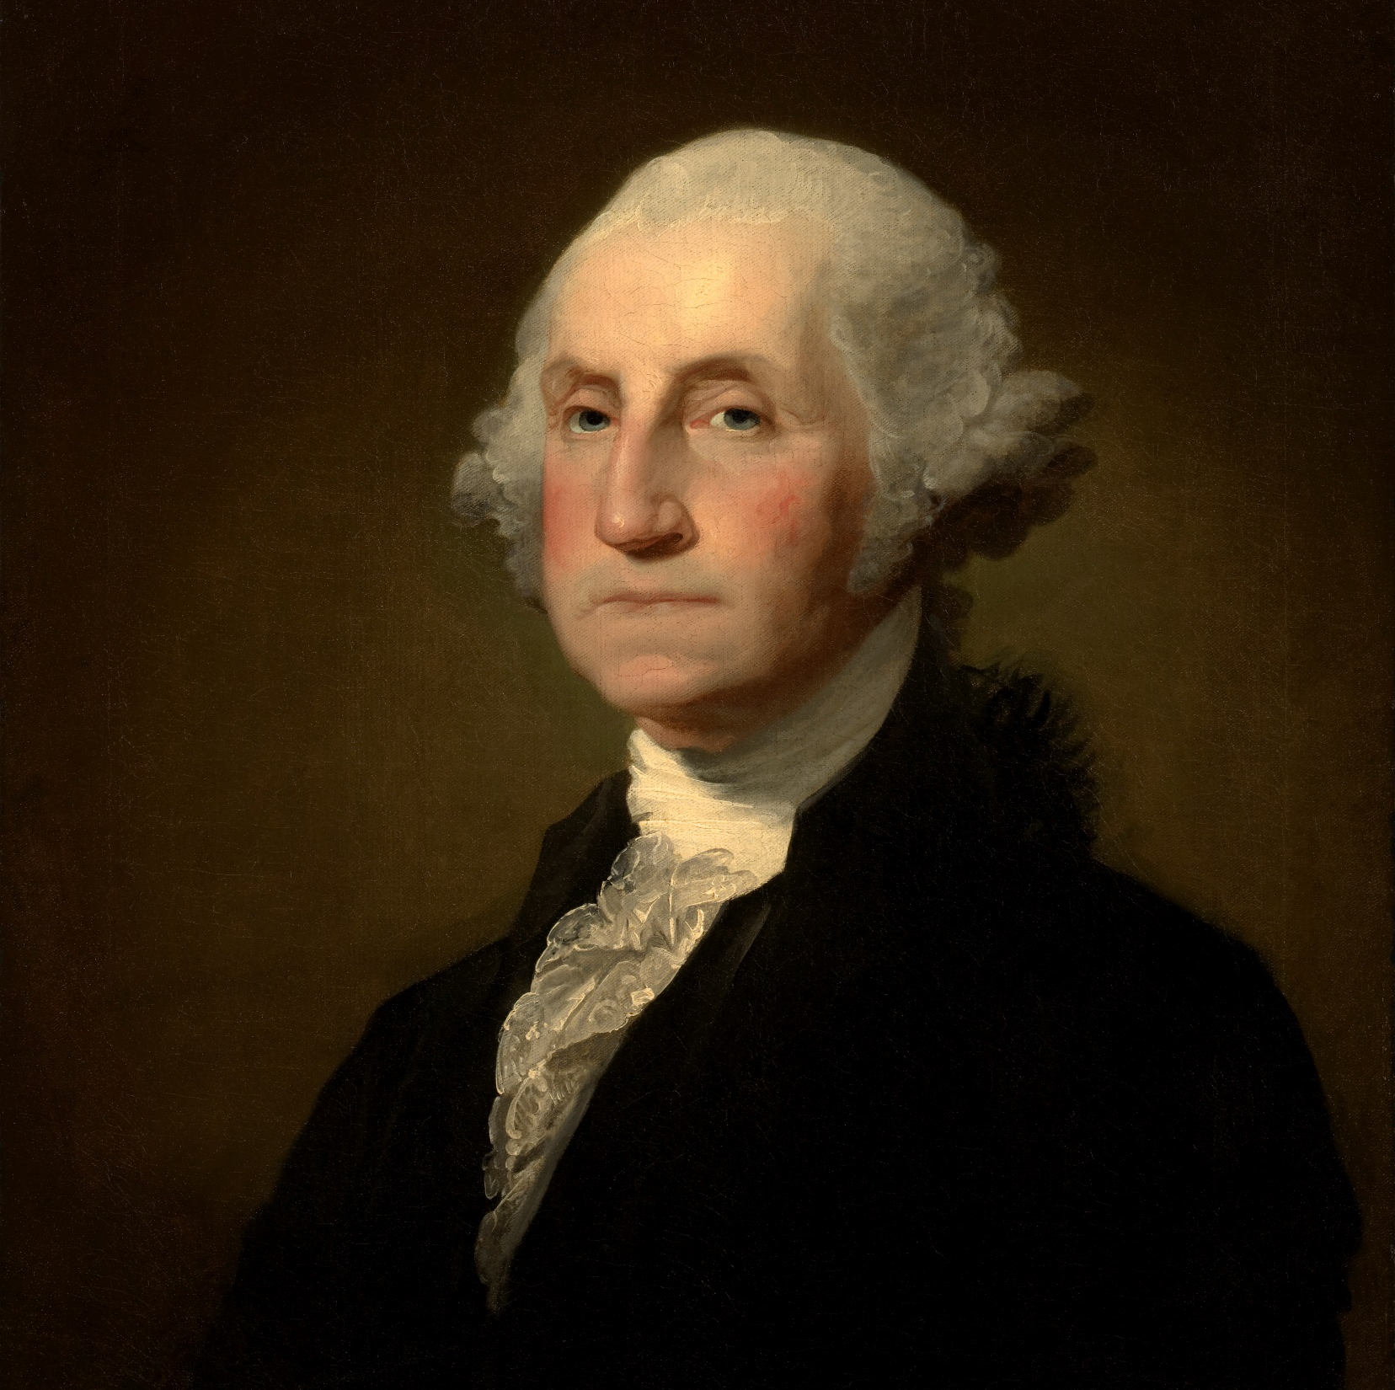
George Washington
Born 1732, Died 1799
First President of the United States
Prior to presidency, Washington had led the Continental Army during the Revolutionary War, resigning his commission and foregoing claims to power at the end of that conflict.
Presided as president of the Constitutional Convention; signed and supported the Constitution.
The only unanimously elected president of the United States.
Notes:
George Washington: https://www.battlefields.org/learn/biographies/george-Washington
When George Washington stepped out onto the pavilion at Federal Hall in New York City on April 30, 1789, he was making history yet again. Newly fifty-seven years old, the American had been unanimously elected as the first president of the United States following the intense ratification debates that enshrined the Federal Constitution and federal government as the modes for how the young country would function. Washington had been masterful in his position as serving as president over the Philadelphia Convention. While rarely speaking during deliberations, he, in fact, would not stop speaking in private about why the Constitution had to be ratified. Along with other Federalists, Washington spent considerable time in the evening hours hammering out differences among colleagues and persuading wary delegates to sign off on the new government. Many of them did so on the promise that it was Washington, and the reputation that he carried, who would oversee the new government.

Slide 5
George Washington
Notes:
The video is embedded in the slide, but here's a link: https://www.battlefields.org/learn/videos/untold/united-states-constitution

Slide 6
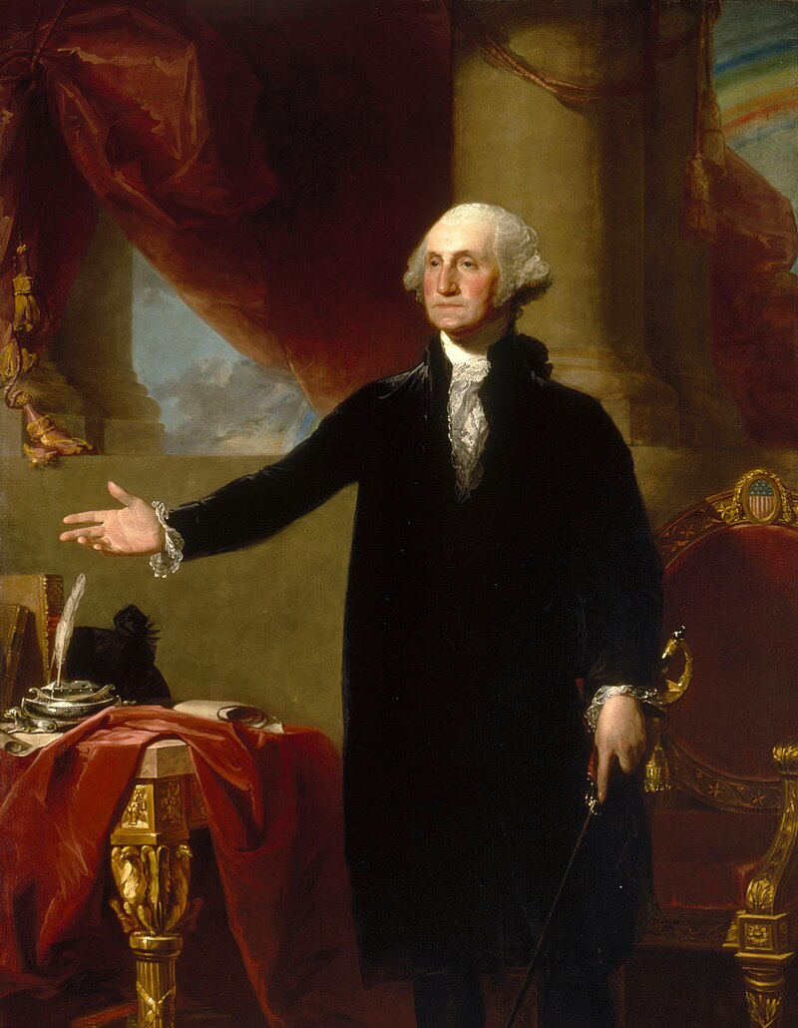
Washington’s Administration
2 Terms as President (1789-1797)
Following the Constitution and setting precedents
Appointed first Federal Judges
Ceremonial Events
Established a Cabinet, his inner circle of personal secretaries and advisors
Welcoming ambassadors and diplomats
Establishment of a National Bank
Conflict in the Northwest Territory
Guiding foreign policy with the Neutrality Proclamation in 1793
In his role as Commander in Chief, he put down the Whiskey Rebellion in 1794
The Jay Treaty in 1794
Refused lifetime appointment, retiring after 2 terms
Notes:
When George Washington was inaugurated as the first president of the United States of America, the parameters and power of the president were to be determined. As president, like when he was general-in-chief of the Continental Army, Washington had to set the standard for all who followed him into the office. The list below represents some of the major things Washington did first as president that established a precedent for future leaders of the position.
Learn more:
The First American President: https://www.battlefields.org/learn/articles/first-american-president-setting-precedent
President George Washington: https://www.battlefields.org/learn/articles/president-george-Washington
George Washington and Neutrality: https://www.battlefields.org/learn/articles/george-washington-and-neutrality
The Jay Treaty: https://www.battlefields.org/learn/articles/jay-treaty
The Whiskey Rebellion: https://www.battlefields.org/learn/articles/whiskey-rebellion

Slide 7
Two Party System
During Washington’s Administration, disagreements over policies and politics lead to the beginnings of the Two-Party System.
Notes:
The video is embedded in the slide, but here's a link: https://www.battlefields.org/learn/videos/untold/americas-two-party-system

Slide 8
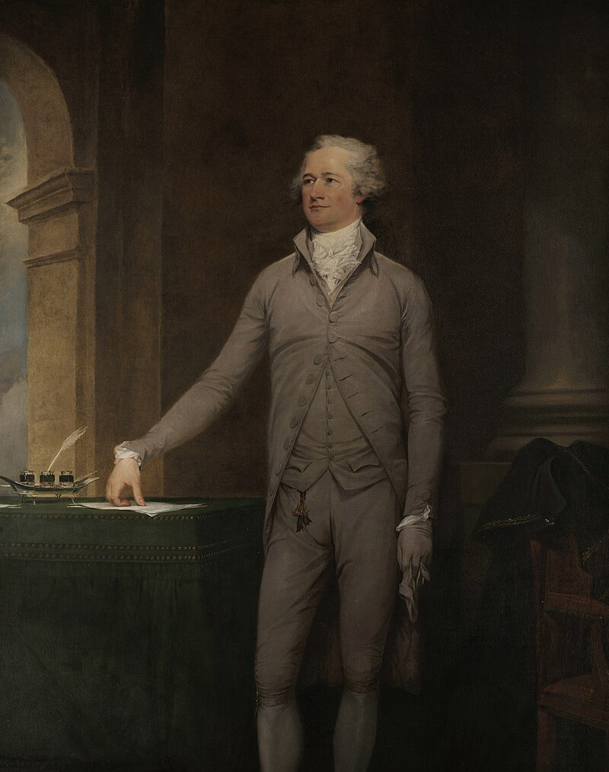
The Federalists
In the Summer of 1787 during the Constitutional Convention, two factions emerged: Federalists and Anti-Federalists.
Federalists wanted to see a strong national government in which state governments were subordinate to the national government.
During Washington’s administration, political parties formed and organized over differing views of how the Constitution was to be interpreted and the legacy of the American Revolution.
Alexander Hamilton (Secretary of the Treasury) led the Federalists.
The “Friends of Mr. Hamilton” were mostly merchants, bankers and men who shared a mercantile view of America.
Notes:
Learn more:
The Rise of Political Parties: https://www.battlefields.org/learn/articles/rise-political-parties
The Federalist Party: https://www.battlefields.org/learn/articles/federalist-party
Alexander Hamilton: https://www.battlefields.org/learn/biographies/alexander-Hamilton
(Image is a painting of Alexander Hamilton in 1792)

Slide 9
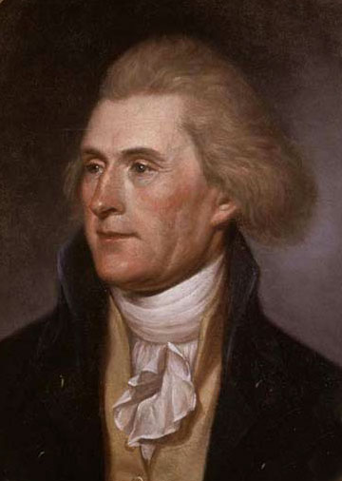
The Anti-Federalists
In the Summer of 1787 during the Constitutional Convention, two factions emerged: Federalists and Anti-Federalists.
Anti-Federalists wanted a new government in which state governments superseded the national government. They also insisted on adding the Bill of Rights to the Constitution.
Thomas Jefferson (Secretary of State) led the Anti-Federalists and frequently debated Hamilton’s views in Washington’s cabinet meetings and in the press.
The “Friends of Mr. Jefferson” were mostly farmers, people from the South and those settling lands to the west; as the Two-Party System emerged, they became known as the Democratic-Republican Party.
Notes:
Learn more:
The Rise of Political Parties: https://www.battlefields.org/learn/articles/rise-political-parties
Anti-Federalists and the Birth of American Party Politics: https://www.battlefields.org/learn/articles/antifederalists-and-birth-american-party-politics
The Jeffersonian Party: https://www.battlefields.org/learn/articles/jeffersonian-party
Thomas Jefferson: https://www.battlefields.org/learn/biographies/thomas-Jefferson
(Image in an early 1790s painting of Thomas Jefferson)

Slide 10
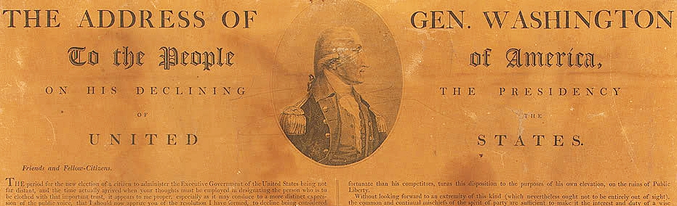
Washington’s Farewell
George Washington declined serving as president for the duration of his life.
After 8 years (2 terms), he was ready to retire to his home, Mount Vernon.
Before he left office, he shared a letter publicly through newspapers with the American people, detailing his hopes and concerns for the future of the country; it is known as “Washington’s Farewell Address.”
He shared reflections on the new political parties, highlighted his administration’s record, and continued to support the Constitution. Washington also tried to reassure and unite the country for the future, since many people worried that the new government would break apart when he left office.
Notes:
Though he likely would have been elected a third time if he’d stayed on, Washington had no such thoughts by the time he started telling close friends he was stepping down. With drafts of Madison’s 1792 address, Washington leaned on his trusted friend Hamilton to write his Farewell Address, which first appeared in print in September 1796. This was Washington announcing to the world why he was stepping away from public service. He summed up his entire political career in the address, noting that he reluctantly took the position out of a sense of duty and that all of his decisions were made to uphold the republican vision of self-government under the Constitution. He also made clear how he felt about his foreign policy initiatives towards Europe. Warning that the United States should not entangle itself in foreign affairs, the address has become noted for its clarity and foreboding of how future administrations would make foreign policy decisions. George Washington would bow out of public life one last time on March 4, 1797.
Read Washington’s Farewell Address: https://www.battlefields.org/learn/primary-sources/washingtons-farewell-address

Slide 11
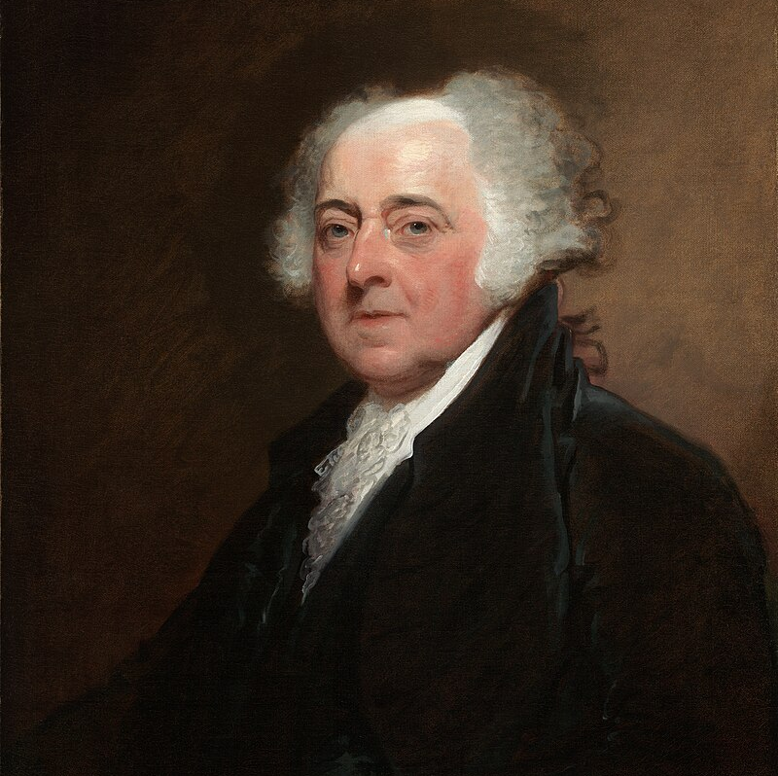
John Adams
Born 1735, Died 1826
Second President of the United States
Prior to presidency, Adams had helped draft the Declaration of Independence and served as a diplomat for the United States in France, The Netherlands, and Great Britain. He was also the first Vice President of the United States, serving with Washington in the Executive Branch of government.
A supporter of the Federalist Party
Notes:
John Adams: https://www.battlefields.org/learn/biographies/john-adams
Mid-1788, Adams returned to Massachusetts and was greeted warmly by his friends and family. The following year, in 1789, Adams was elected Vice President of the United States under George Washington's administration. Adams presided over the Senate as a Federalist and worked closely with other cabinet members, including Alexander Hamilton and Thomas Jefferson. At the end of Washington's presidency, Adams and Jefferson campaigned against each other in the election of 1796. With support from Alexander Hamilton and his fellow Federalists, John Adams became the second President of the United States. During his presidency, Adams faced many domestic and international controversies, including the XYZ affair, the Alien and Sedition Acts, and the beginning of the Quasi-War with France. Adams also successfully rebuilt the United States Navy, giving him the title "the father of the American Navy" and passing a law establishing the Library of Congress. Adam ran for reelection in 1800 against Thomas Jefferson and Arron Burr and did not receive enough votes.

Slide 12
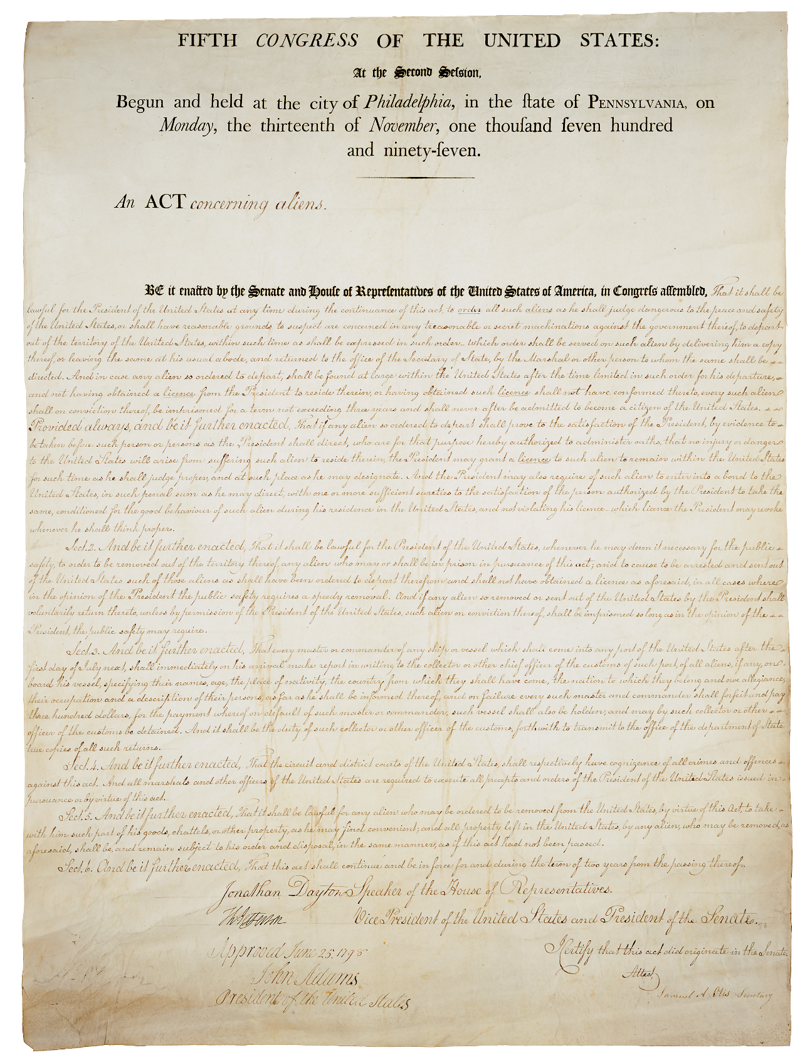
Adams’ Administration
1 Term as President (1797-1801)
XYZ Affair
Established the Department of the Navy
Alien and Sedition Acts
Response to the unpopular Alien and Sedition Acts included the Virginia and Kentucky Resolutions
Quasi-War
Splintering of the Federalist Party
Moving the federal capital to Washington City (Washington D.C.)
Lost the Election of 1800
Notes:
(Image is of part of the Alien and Sedition Acts)
The Federalist Party had many successes throughout the late 1700s in the Legislative Branch. In the Executive Branch, the second President of the United States, John Adams, was a member of the Federalist Party and was to be the only Federalist president in US history. Once the early 1800s arrived, the Federalists began to lose support among the American voters, allowing the rival Jeffersonian Party to garner support.
Learn more:
XYZ Affair: https://www.battlefields.org/learn/articles/xyz-affair
Alien and Sedition Acts: https://www.battlefields.org/learn/articles/alien-and-sedition-acts
Virginia Resolutions: https://www.battlefields.org/learn/primary-sources/1798-virginia-resolutions-and-extracts-address-people
Kentucky Resolutions: https://www.battlefields.org/learn/primary-sources/1798-kentucky-resolutions
Quasi-War: https://www.battlefields.org/learn/articles/quasi-war
Election of 1800: https://www.battlefields.org/learn/articles/election-1800-adams-vs-jefferson

Slide 13
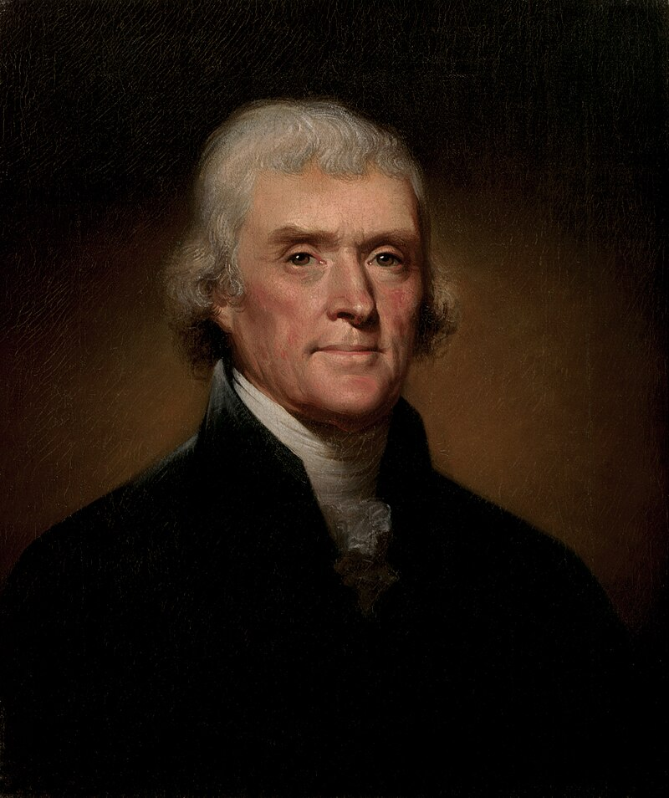
The Election of 1800
John Adams ran for re-election for the Federalist Party, despite his unpopularity.
Thomas Jefferson, Adams’ vice president despite their differing political parties and views, ran with Aaron Burr for the Democratic-Republican.
Adams and Jefferson had been close friends, but a decade of political differences, undermining and name-calling had estranged them by 1800.
Jefferson and Burr tied with votes; Hamilton then rallied Federalist votes for Jefferson, but it still took the House of Representatives 5 days to choose a victor.
Finally, on February 17, 1801, abstained votes allowed Jefferson to receive a majority, and he was inaugurated on March 4, 1781.
Notes:
The Election of 1800: https://www.battlefields.org/learn/articles/election-1800-adams-vs-jefferson
The campaign and election of 1800 are rightfully remembered as being both bitter and divisive. Perhaps no other election, save for the elections of 1824 or 1828, conjured up more partisanship than the one between Adams and Jefferson. The partisan newspapers ran attack ads daily. Both lead candidates remained largely detached from the political rancor, though Jefferson certainly played a greater role in directing editors what to print.
As president, Adams was campaigning for reelection. At times, he privately confessed his yearning for retirement, but he also remained a political fighter who could not see himself bowing out, particularly to forces he vehemently opposed. To rally party unity, the Federalists chose South Carolina’s Charles C. Pinckney as his running mate. The Republicans nominated Jefferson and New York’s Aaron Burr as his vice president nominee. Because of the way the Constitution was written, the delegates in the electoral college could cast two votes each. It could mean the party’s two candidates could be divided if one came in second in the overall tallies, such as Jefferson becoming vice president under Adams and a rival political party. This had caused problems in the previous election, and would largely define the current election’s outcome.
Election day was December 3, 1800. By this point, the contest had already produced several results. One such result showed that neither political party was above the standard of playing fair. In Georgia, Virginia, and New York, rival factions switched voting district regulations in favor of the majority. Balloting had been underway for weeks, and the clear result showed that Adams was coming up short in key areas that had previously been Federalist strongholds. Indeed, the incumbent worried he would receive fewer votes than his running mate Pinckney. In the end, Adams would receive 65 votes to Pinckney’s 64. However, both Jefferson and Burr received 73 each, creating a tie for the presidency. Burr had been a controversial pick from the outset. Though a generation younger than Jefferson and not his equal in politics, the younger candidate was equally ambitious. Too ambitious for some, including rival Alexander Hamilton. When the Republican ticket was assembled, Burr made it clear he would run behind Jefferson, as it was widely accepted that Jefferson was the literal face of the party. Burr even indicated this to the future president. However, as the election resulted in a tie between the two men, Burr suddenly indicated to some that he intended to fight for the presidency, reversing everything he had promised up until that point.
The following weeks provided the necessary actions to see a victor emerge from the stalemate. And the person who cast the fate of the election was none other than Alexander Hamilton. We would assume Hamilton would do everything in his power to deface and eliminate Jefferson, his longtime political enemy. But Hamilton felt Burr was actually the greater political threat. Though he differed immensely with Jefferson ideologically, he also knew Jefferson to be temperate towards government power. Burr, on the other hand, was viewed as dangerously ambitious and could not be trusted with the reigns of the federal government. Hamilton secretly put together his terms for rallying Federalist support to Jefferson: the next administration could not undo the financial and bank system; it could not remove Federalist appointees and it had to preserve the US Navy, among other things. Hamilton had his scheme while other prominent Federalists disagreed and still viewed Jefferson as their ultimate target to defeat. Yet the same pitch was made to Burr who rejected such an agreement.
Starting on February 11, 1801, thirty-five votes were conducted in the House of Representatives over the next five days to choose a victor. All remained deadlocked in a tie. As the partisan infighting occurred, real threats of insurrection broke out across the country. Many factions aligned with the Republicans threatened to act if the election was stolen from Jefferson. Recall, this was shaping up to be the first real transfer of political power at the national level; the Federalists had held the presidency since 1789. Rumors circulated of a government coup d’etat and even a plan to assassinate Jefferson if he tried to take the presidency without consent. Finally, a compromise was broached with Delaware’s James Bayard, a Federalist, and Maryland and Vermont, two states that remained deadlocked. If Bayard abstained from voting, it would lower the state threshold needed to break the tie. As this was being debated, Jefferson came to the decision to accept the terms of Hamilton’s scheme. Though never admitting it, his administration would not challenge a single stipulation put forth by his longtime political rival. The Federalist plan was now set. On February 17, during the thirty-sixth vote in the House of Representatives, Delaware abstained and did not cast a vote. The Federalist delegates of Maryland, South Carolina, and Vermont also did not vote, allowing for Jefferson to now claim a clear majority of the delegates that offset those that were no longer being counted. Thomas Jefferson had officially become the president-elect of the United States.

Slide 14
Notes:
Learn more at www.battlefields.org

